Slide 2
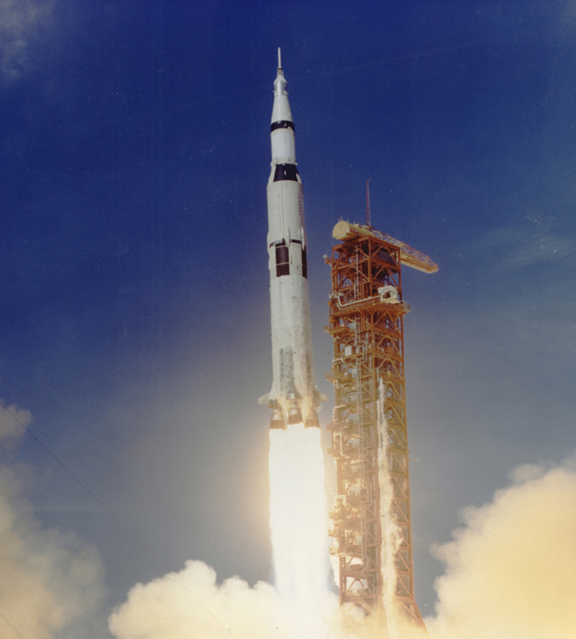
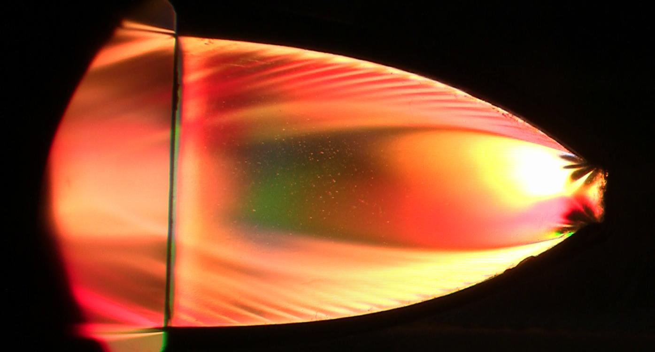
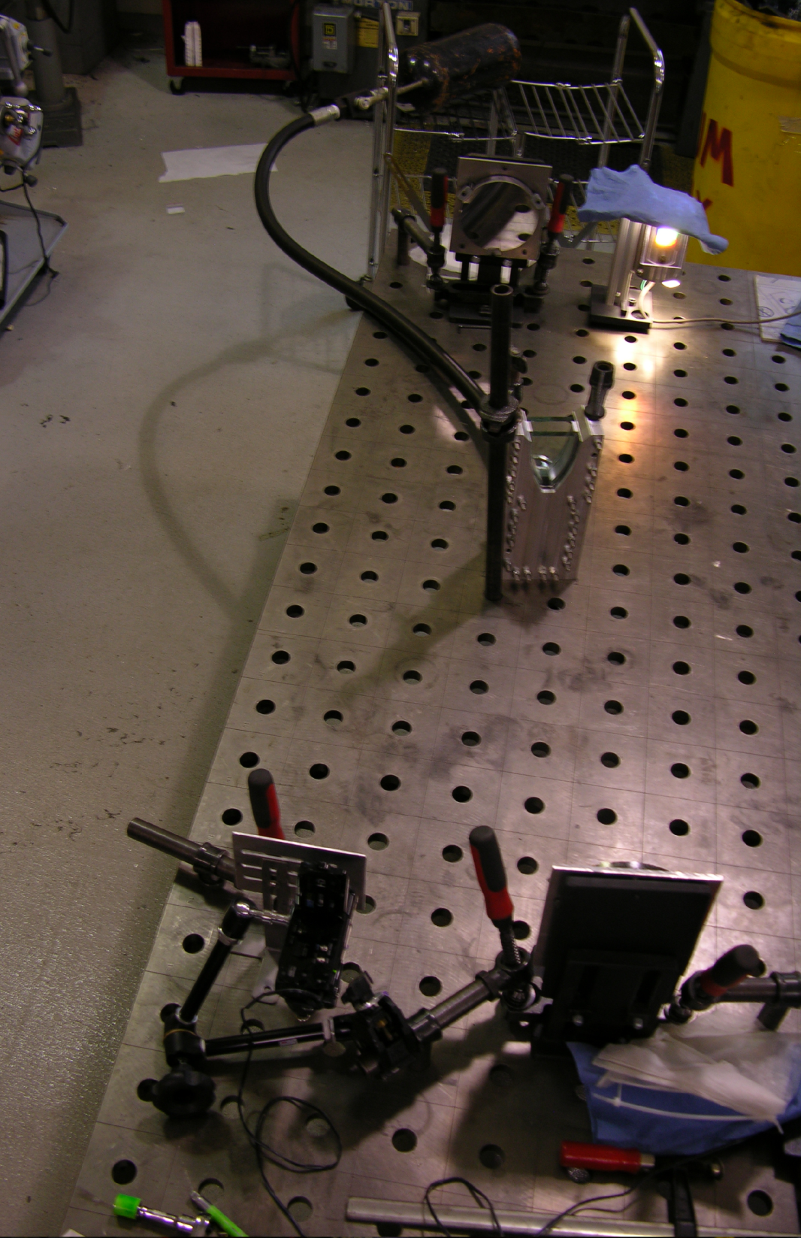
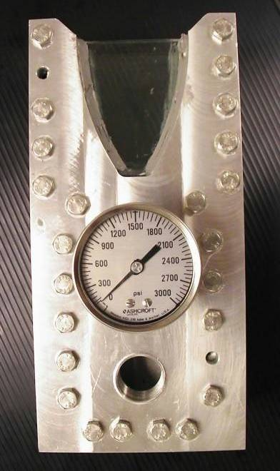
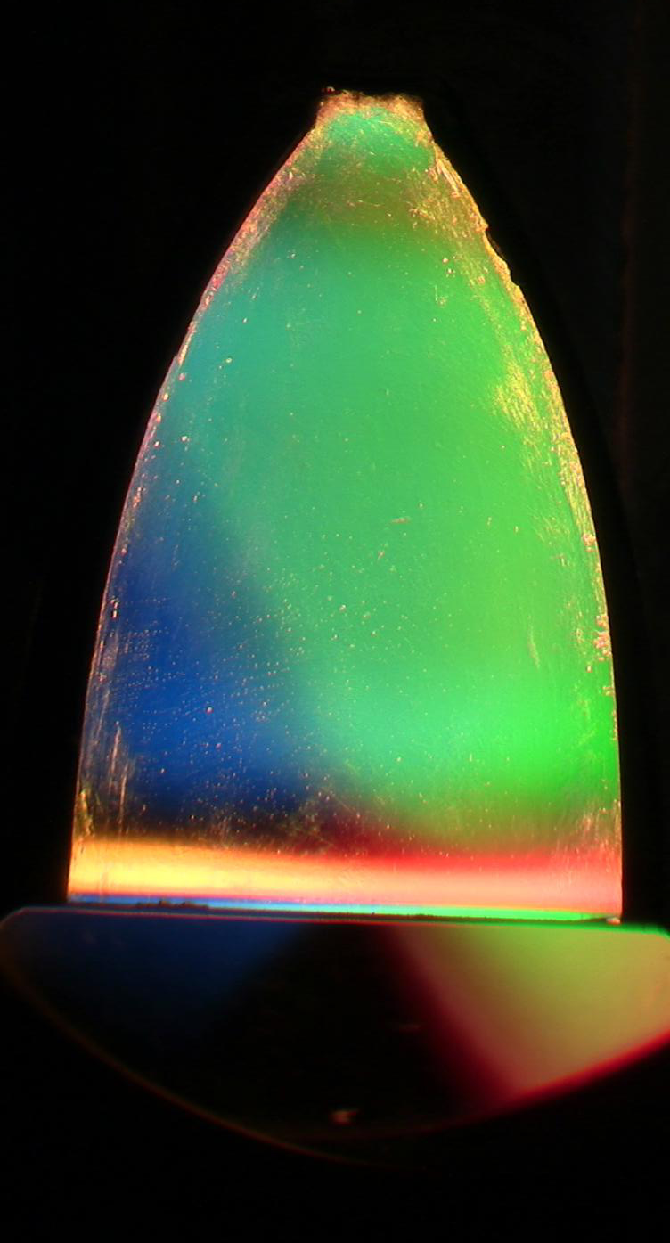
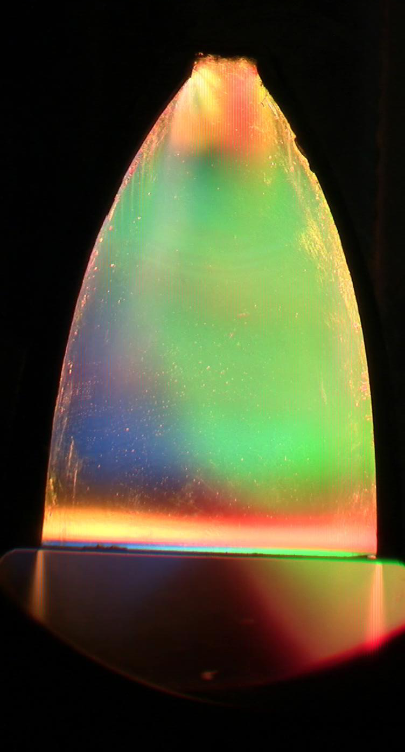
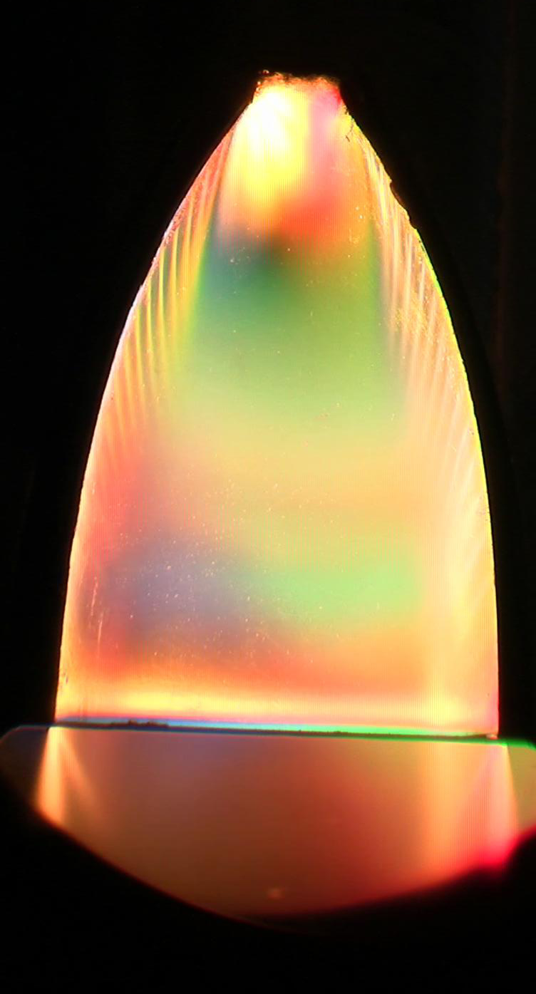
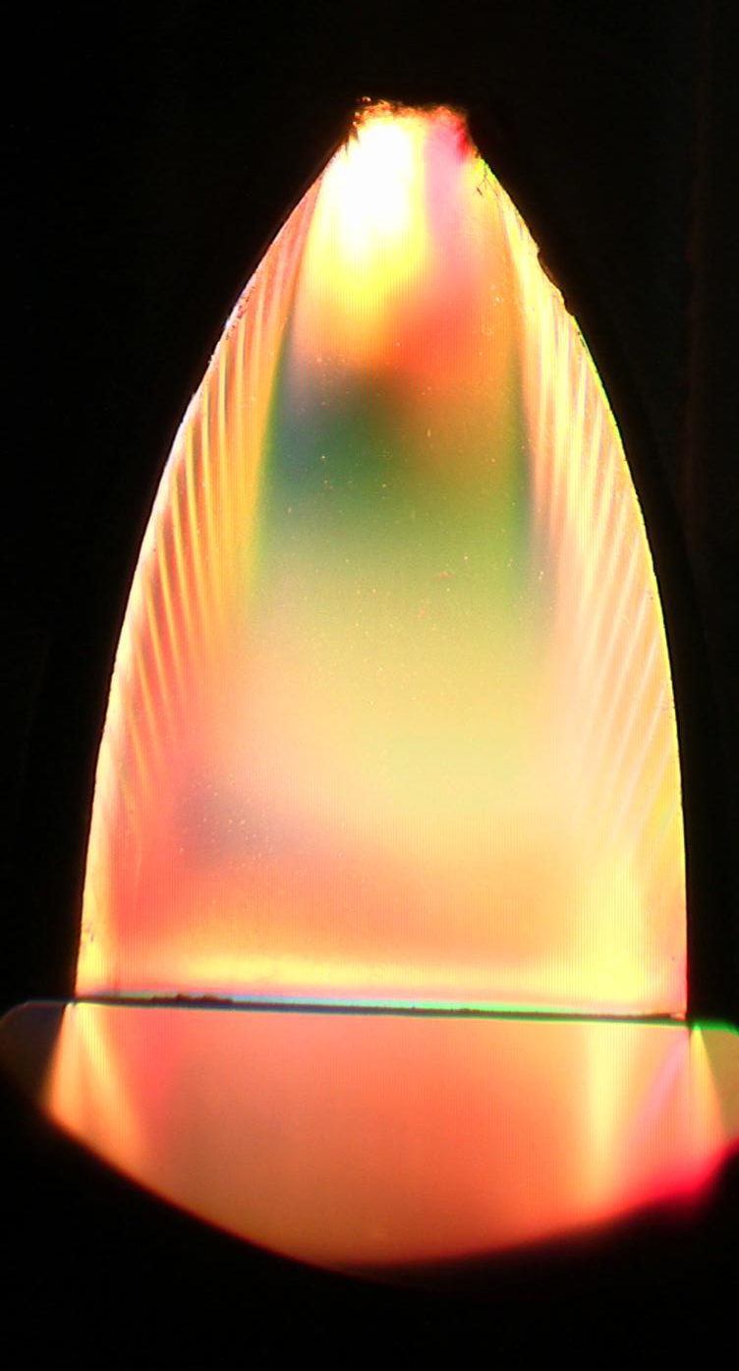
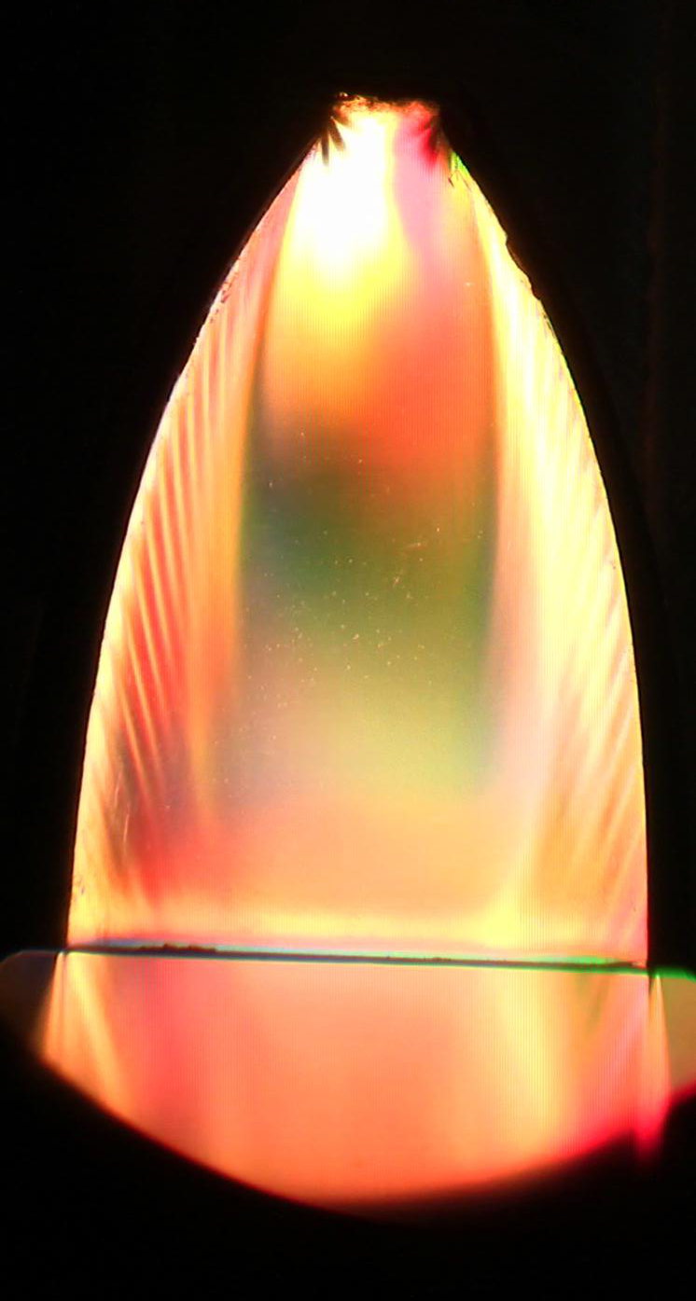
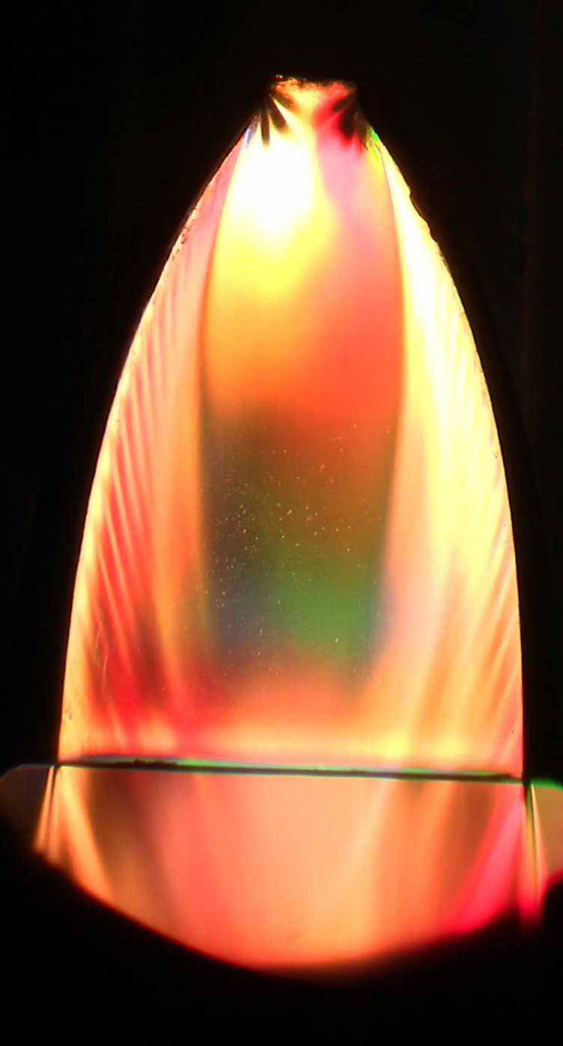
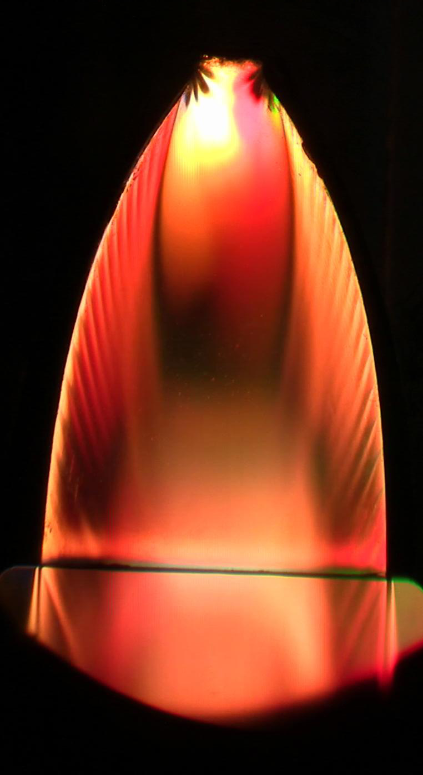
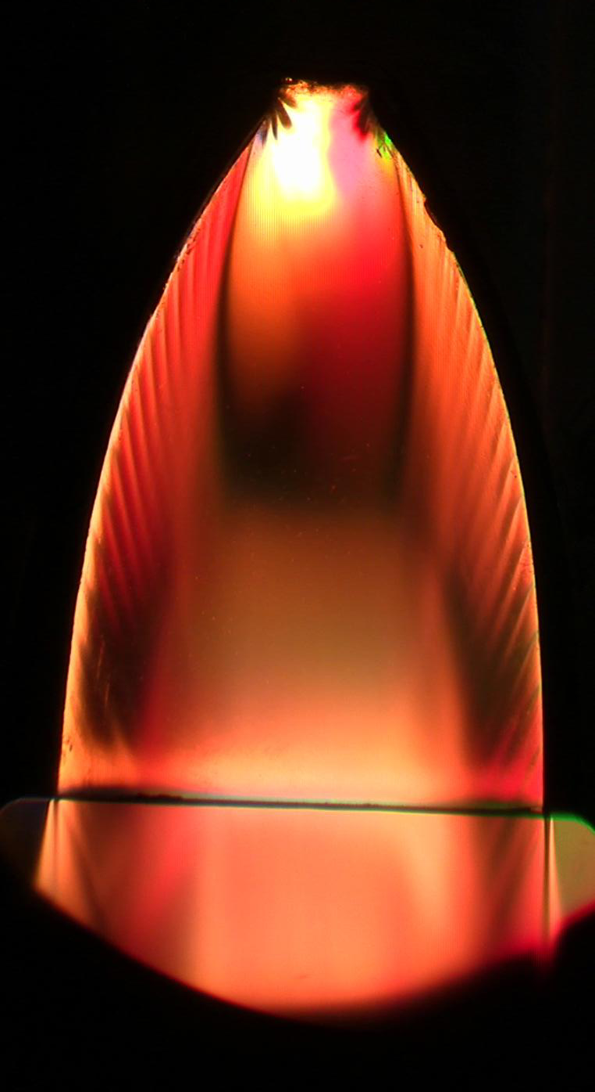
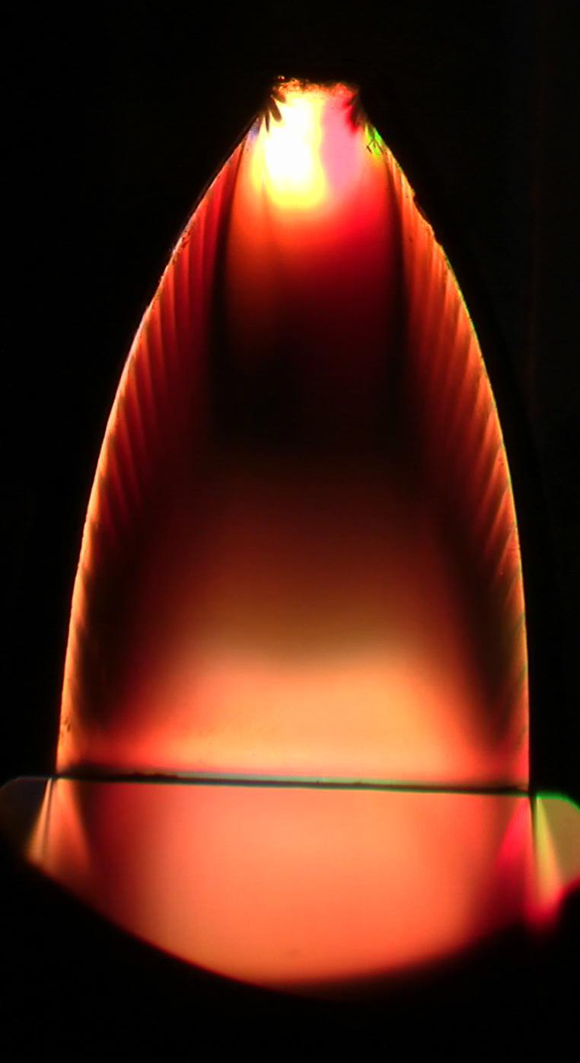
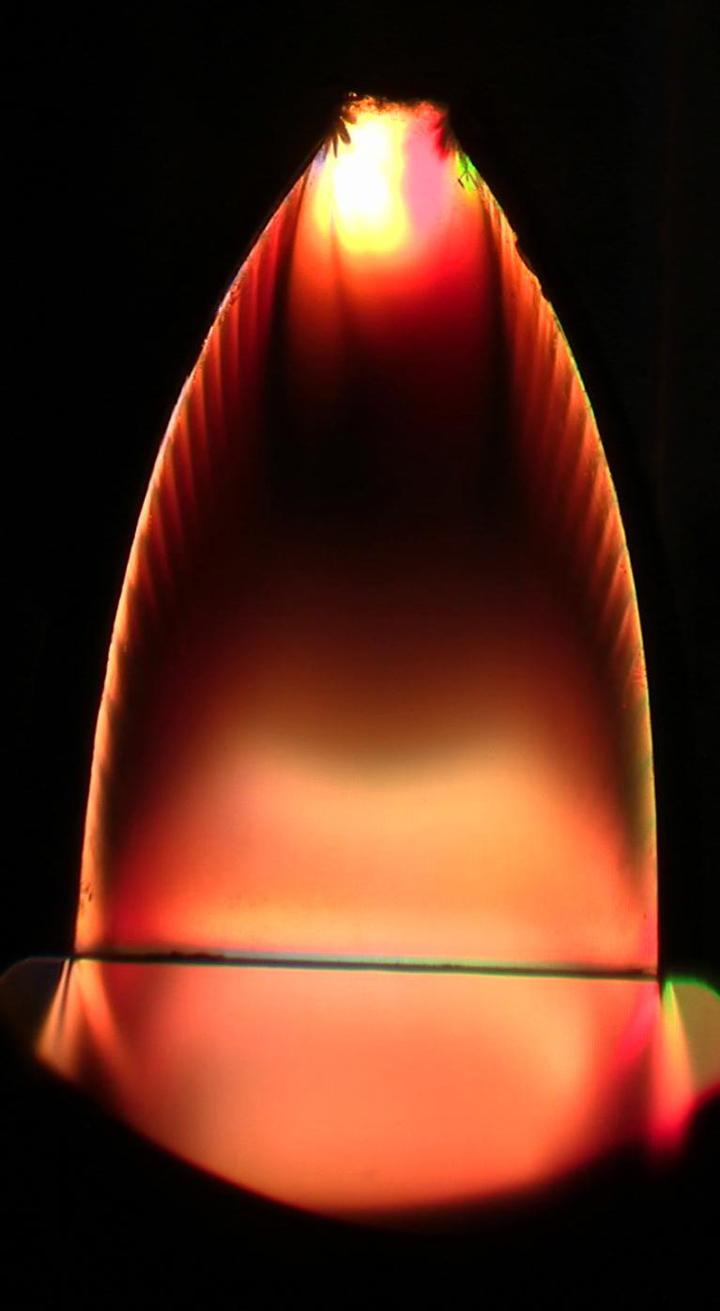
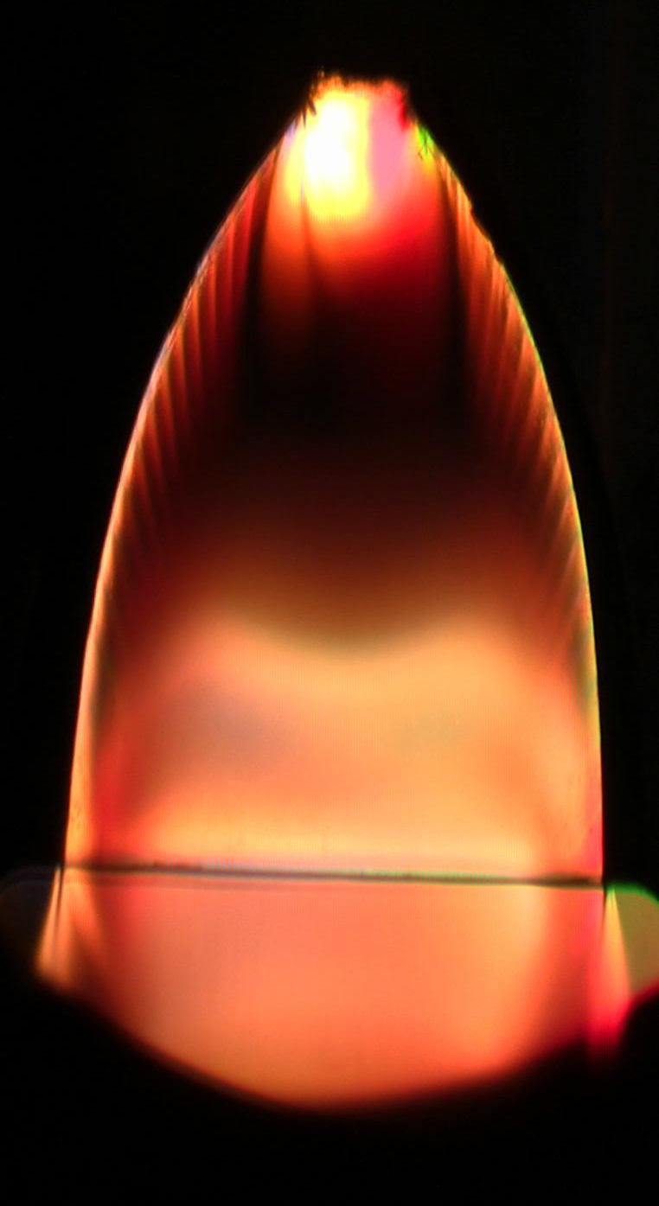
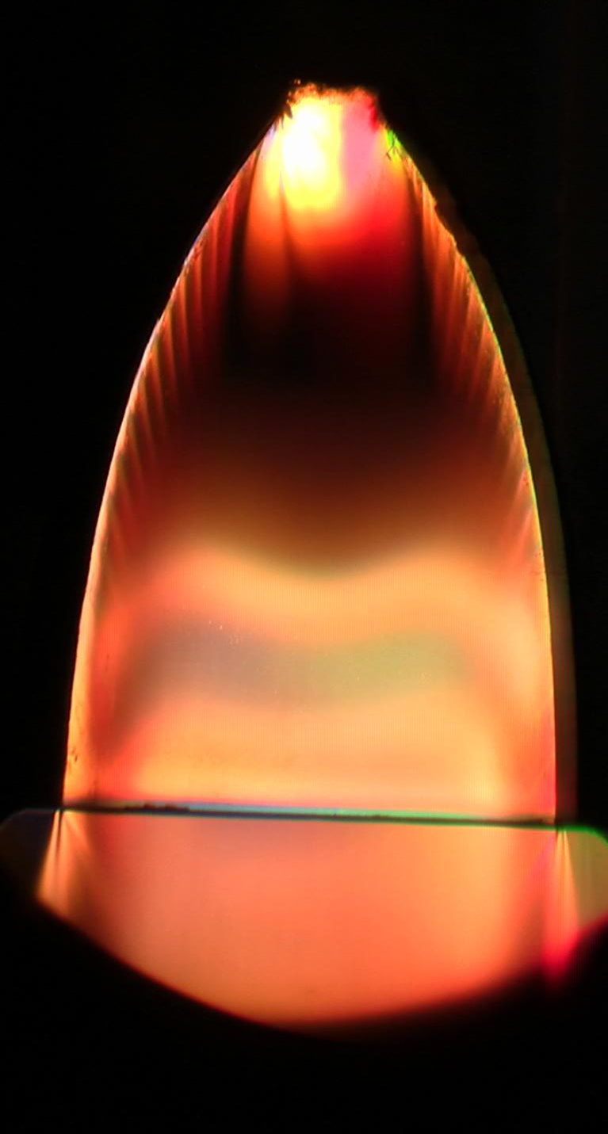
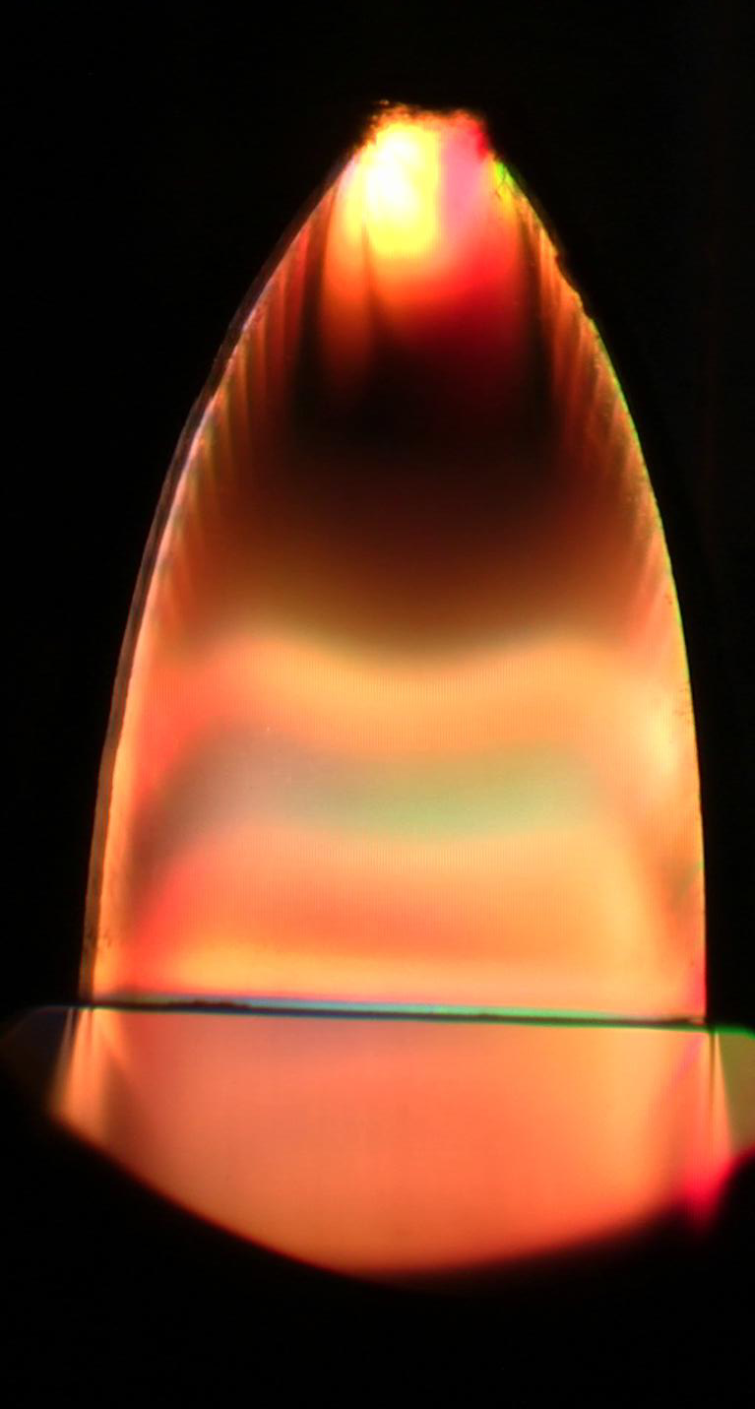
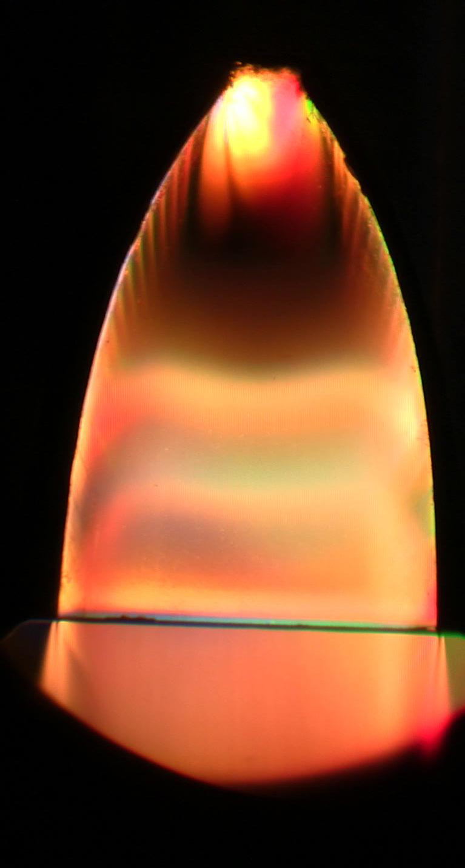
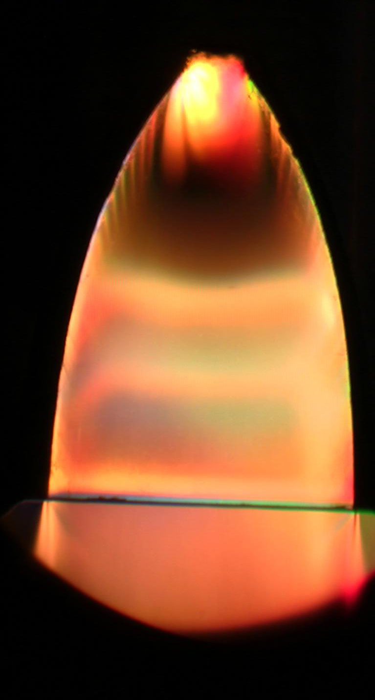
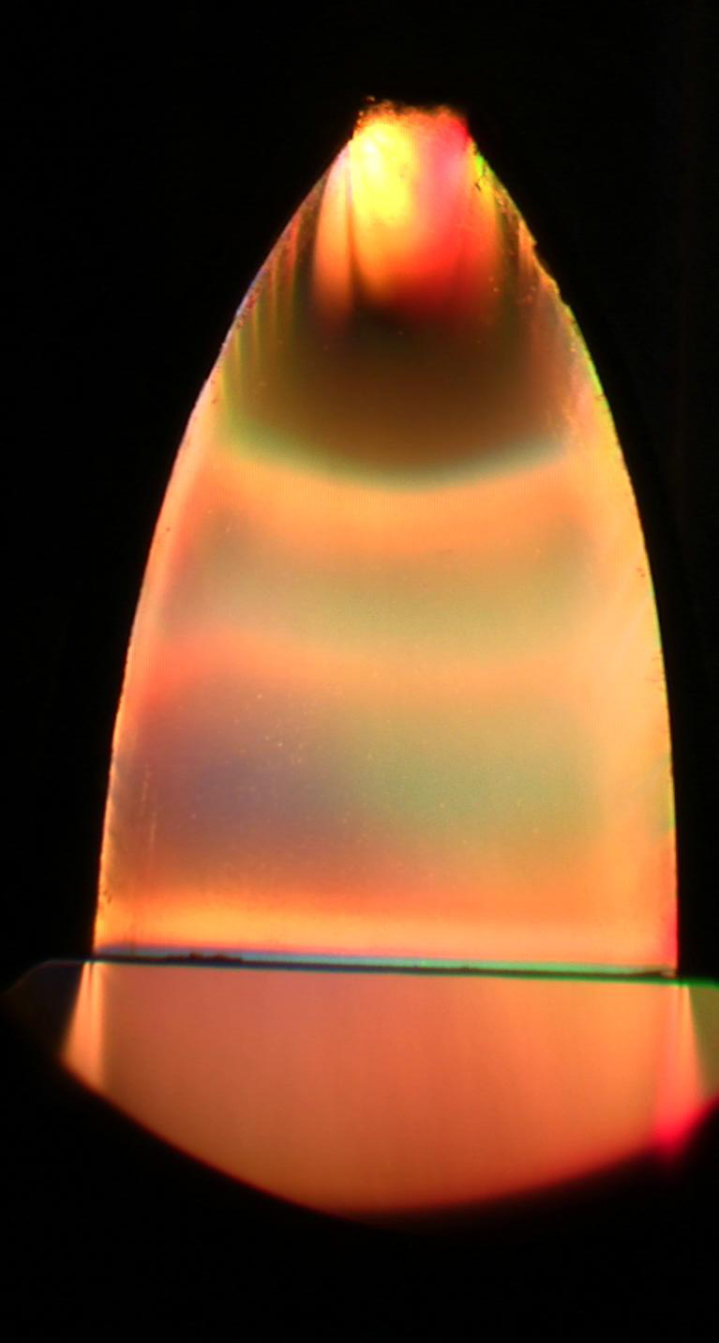
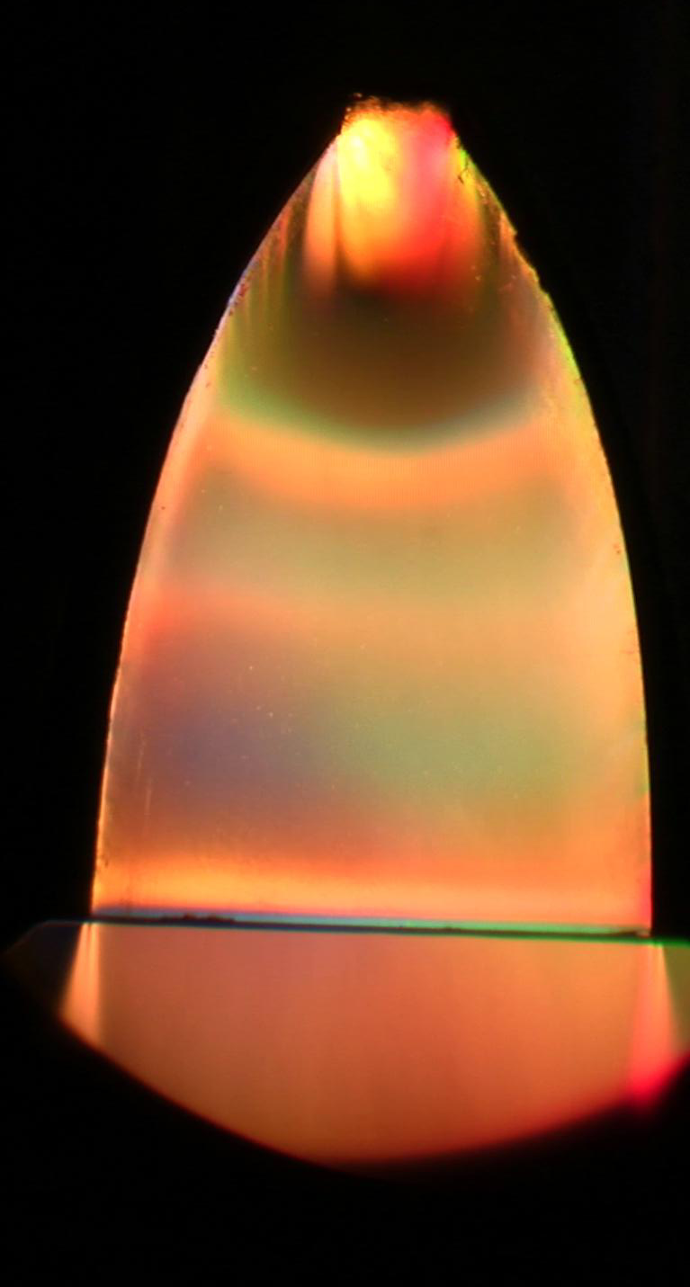
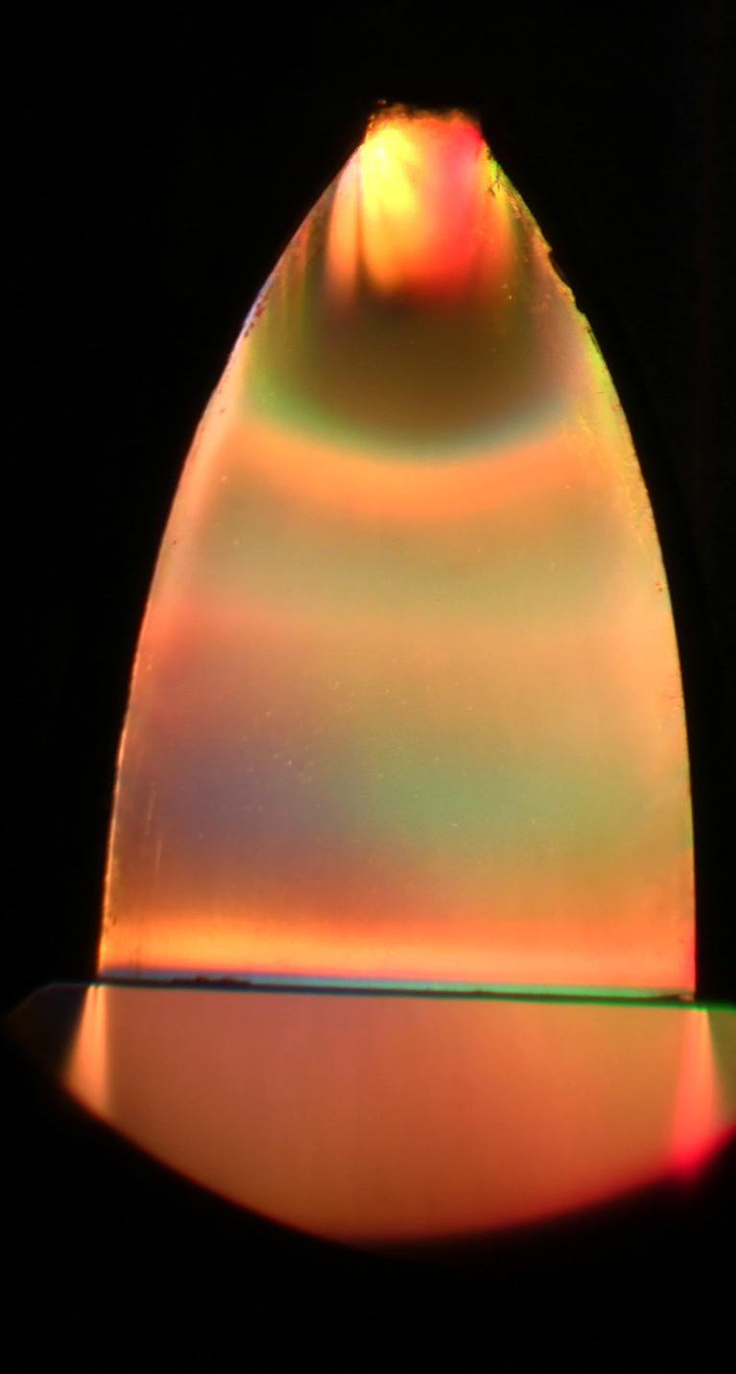
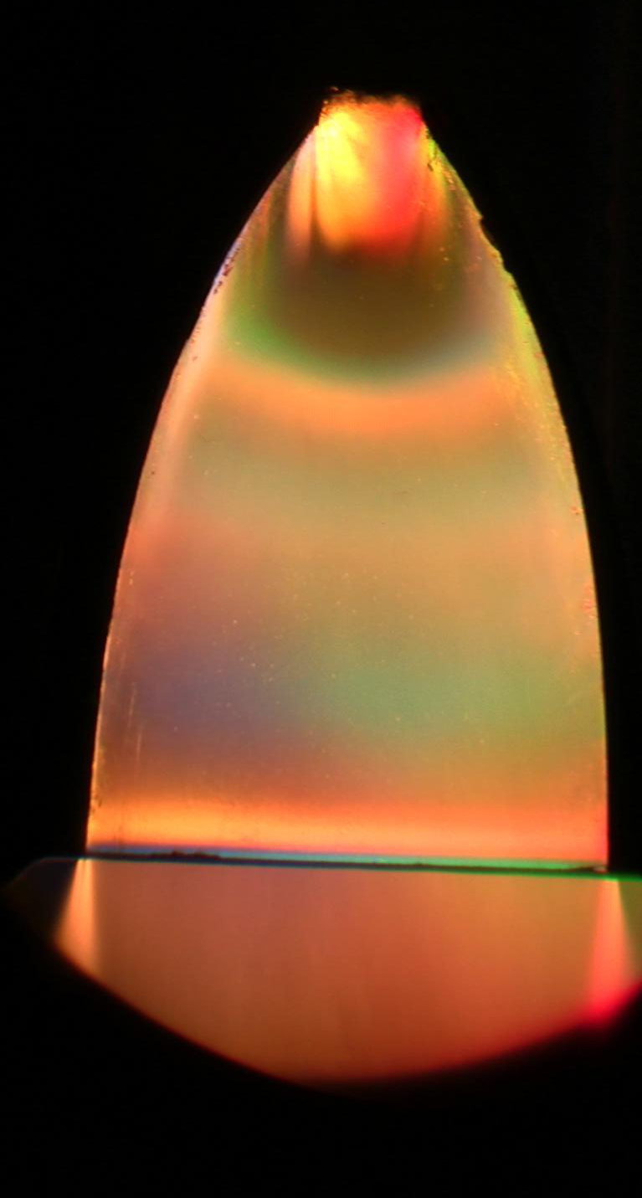
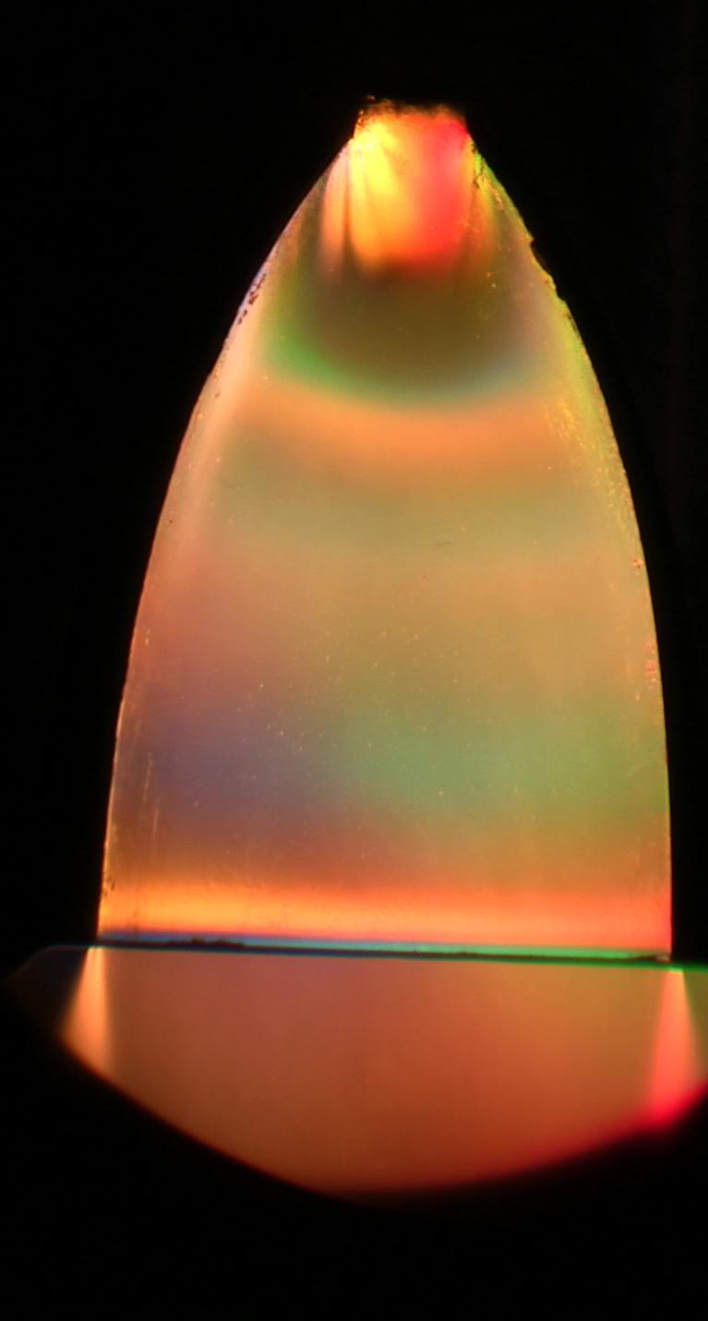
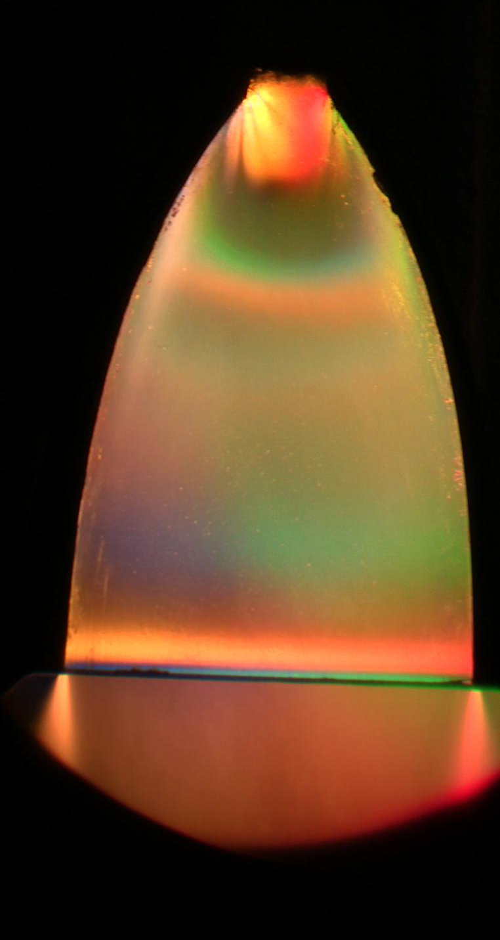
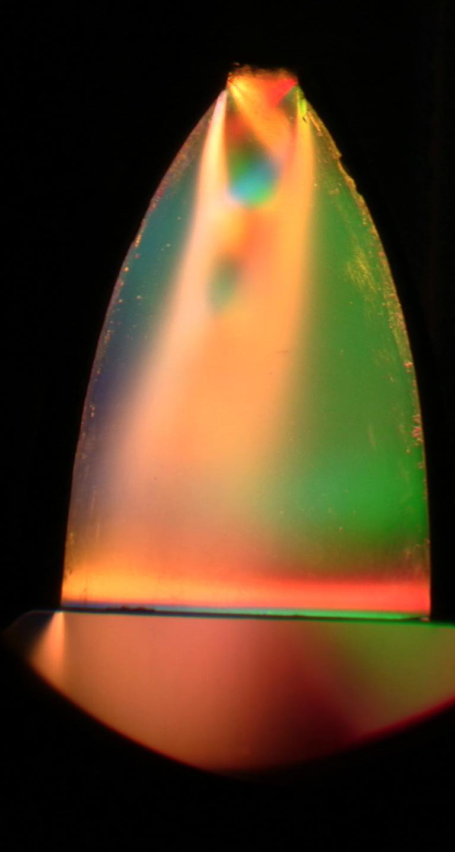
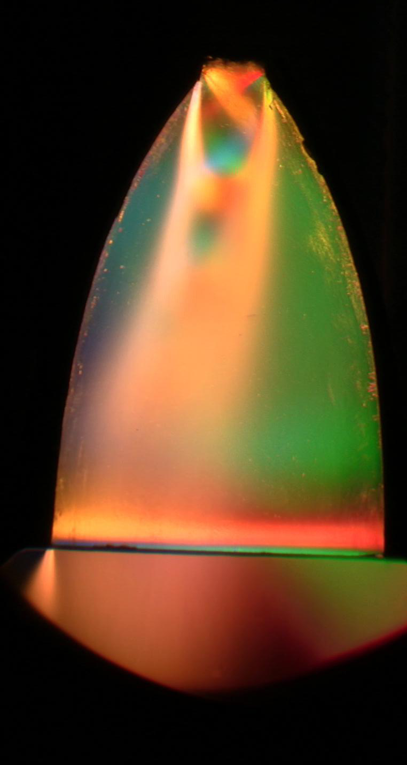
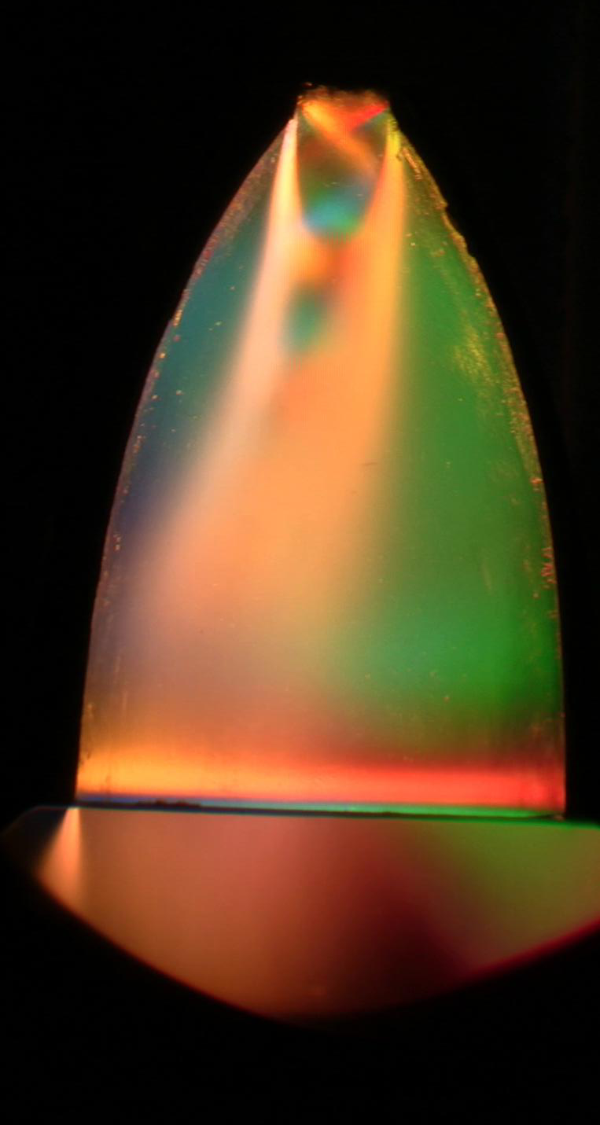
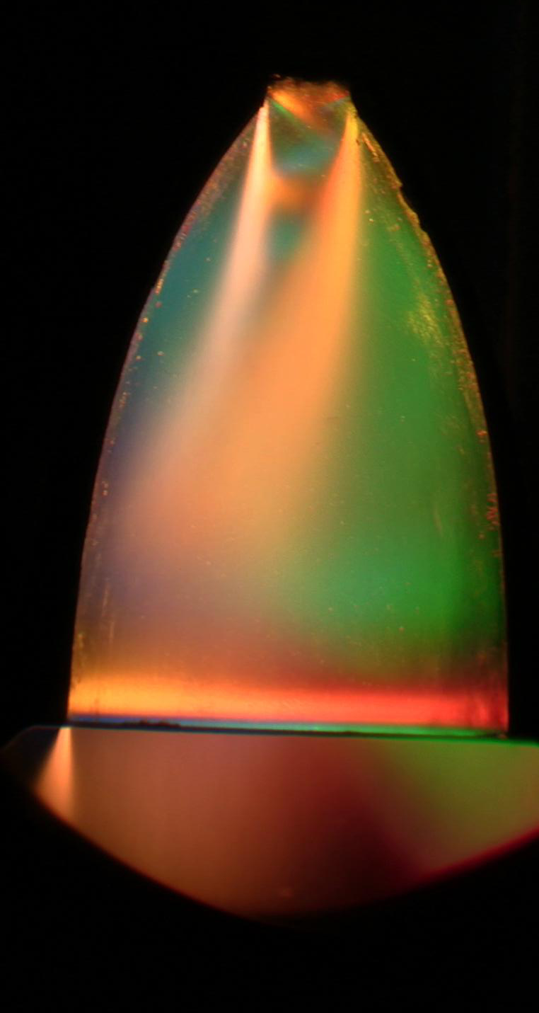
Color Schlieren Imaging of Internal Shock Structure in Super Sonic Planar Rocket Nozzle
Peter Tkacik ¹, Russell Keanini ², Nilabh Srivastava³, Sam Hellman⁴, University of North Carolina at Charlotte, Michael P. Tkacik⁵, Clemson University, Den Baseda⁶, North Carolina State University
Conclusions
Simple, inexpensive, safe tests and the results are spectacular.
From the parabolic nozzle, we see the shock formation inside throughout the nozzle
We had a clear Restricted Shock Separation (RSS) during the low pressure test on the parabolic nozzle.
The conical nozzle showed clear Free Shock Separation (FSS)
Figure 1. The Apollo Astronauts were shaken so badly by nozzle side load problems that they reportedly couldn’t see the emergency eject button (NASA image).
High pressure Argon tank
Introduction
Numerous failures have resulted due to a lack of understanding concerning side-load issues.
Visualization techniques can help in the analysis of side-load failure mode. Color Schlieren imaging is a useful techniques for exploring the side-loading phenomena.
Goals
Use a color Schlieren imaging system to visualize the shock structure inside a rocket nozzle. Test at high nozzle pressure ratios (NPR > 100). In particular, look for Shock Separation. Use this to look for the source of rocket side loads.
Separation (FSS) and Restricted Shock Separation (RSS)
Color light source
Mirror #2
Planar Rocket nozzle
Mirror #1
The high pressure ratio nozzle:
Modified for a variety of nozzle geometries
Steel and high strength tempered glass panes
High pressure tank
A high pressure tank and a ball valve for fast pressure response was charged with Argon gas to 150 MPa can be recharged quickly for repeat experiments.
Light source
Test Run
Capture test firings with digital high definition CCD camera Blu-Ray© (*.M2TS) format at 30 fps
Experiment run times 10 seconds with maximum pressure for only 0.10 seconds
Circular knife edge and camera
Figure 4. Test fixtures
Mirror stand
Light rays
Mirror stand
Results of experimental color Schlieren imaging of internal rocket nozzle flow:
Nominal maximum mach number (NMMN) ≅4.4
Flow field image compared well against CFD results.
Nominal maximum mach number (NMMN) ≅2 revealing Restricted Shock Separation (RSS)
Rocket Nozzle
High pressure lines
Knife edge
Figure 2. Nozzle
High pressure tank and ball valve
Camera
Figure 3. Test schematic
Above and below are the images sequenced from zero pressure up to about 150 MPa (2200 psi) and then slowly back down to ambient showing a collection of internal shocks and Mach waves
¹ptkacik@uncc.edu, ²rkeanini1@uncc.edu, ³nsrivast@uncc.edu, ⁴shellma3@uncc.edu, ⁵mtkacik@clemson.edu, ⁶dbaseda@ncsu.edu

