Slide 1
EP34A-01: Exploring How Weathering Related Stresses and Subcritical Crack Growth May Influence the Size of Sediment Produced From Different Rock Types. (Invited)
Martha Cary Eppes
University of North Carolina at Charlotte
Bernard Hallet – University of Washington
Gregory S Hancock - College of William & Mary
Peter Mackenzie-Helnwein – University of Washington
Russell Keanini - University of North Carolina at Charlotte
Notes:
The production of sediment from rock fundamentally occurs through physical weathering; and physical weathering occurs through cracking. There is a respectable body of literature out there with observations of weathering that has already occurred, well-entrenched ideas about the types of stresses that may lead to that cracking; but very little if any thought given to the process of cracking itself.

Slide 2
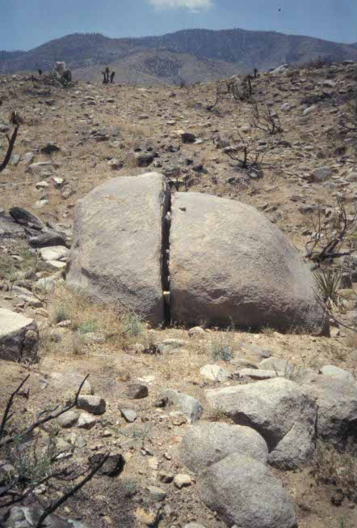
Styles of Fracture Influence Sediment Size
Through-going Cracking
Notes:
The production of sediment from rock fundamentally occurs through physical weathering; and physical weathering occurs through cracking. There is a respectable body of literature out there with observations of weathering that has already occurred, well-entrenched ideas about the types of stresses that may lead to that cracking; but very little if any thought given to the process of cracking itself.

Slide 3
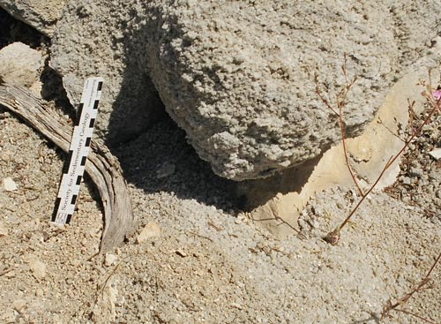
Styles of Fracture Influence Sediment Size
Intergranular Cracking

Slide 4
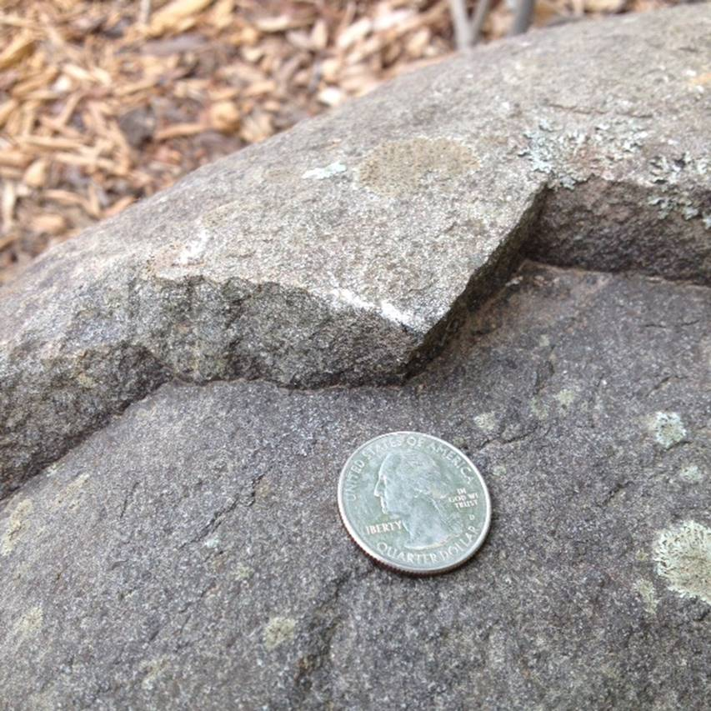
Styles of Fracture Influence Sediment Size
Exfoliation/Spalling/Flaking

Slide 5
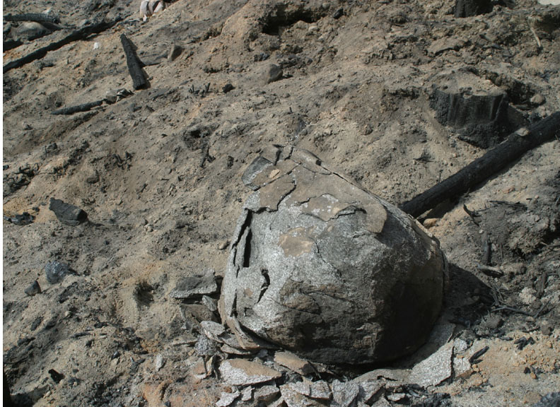
Notes:
The production of sediment from rock fundamentally occurs through physical weathering; and physical weathering occurs through cracking. There is a respectable body of literature out there with observations of weathering that has already occurred, well-entrenched ideas about the types of stresses that may lead to that cracking; but very little if any thought given to the process of cracking itself.

Slide 6
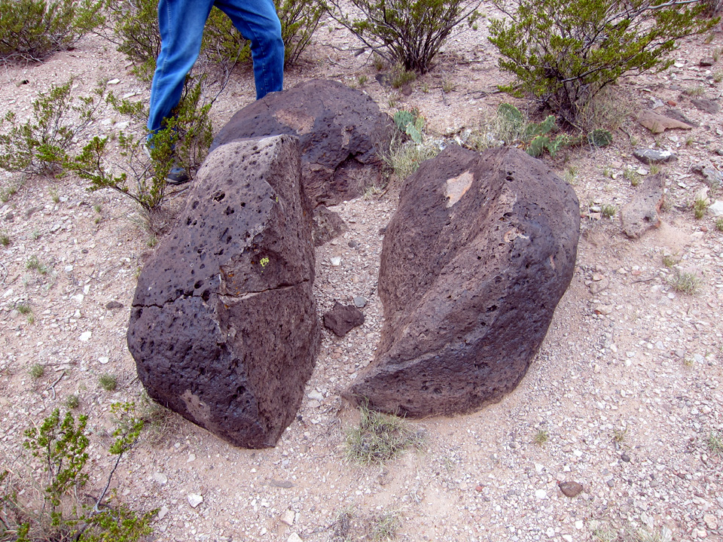
Notes:
I couldn’t understand the style of cracking until I understood the cracking itself

Slide 7
New Perspectives on Mechanical Weathering
and Sediment Production
through Fracture Mechanics

Slide 8
New Perspectives on Mechanical Weathering
and Sediment Production
through Fracture Mechanics
FRACTURE MECHANICS PRIMER

Slide 9
New Perspectives on Mechanical Weathering
and Sediment Production
through Fracture Mechanics
FRACTURE MECHANICS PRIMER
Some food (cracks?) for thought
insights into sediment size
Notes:
Food for though

Slide 10
Fracture Mechanics Primer
Fracture Growth in Brittle Elastic Solids (a.k.a. rock)
Crack
growth
rate
ΔL/T
K (MPa m^{1/2} )

Slide 11
Material “Fails” when
K > Kc (a.k.a. Fracture Toughness)
Kcritical
Crack growth is catastrophic
Crack
growth
rate
ΔL/T
K (MPa m^{1/2} )

Slide 12

Virtually All Geomorphology Studies Stop Here
Kcritical
Is stress-$x$ > Kc?
Crack
growth
rate
ΔL/T
K (MPa m^{1/2} )

Slide 13
Fractures Grow at Subcritical Stress Levels
K_{th}
K_{c}
Subcritical
Crack
growth
Crack
growth
rate
ΔL/T
K (MPa m^{1/2} )

Slide 14
Likely, most rock breakdown on hillslopes
is
subcritical crack growth
K_{nth}
K_{c}
Crack
growth
rate
ΔL/T
Weathering Stresses
K (MPa m^{1/2} )
Notes:
So if that is the case, then what do we need to know about sc crack growth?
Most weathering stresses likely fall in this stress range, so that means that cracks are going very slowly, over very long time scales.
Futhermore, there are many processes that constitute sccg

Slide 15
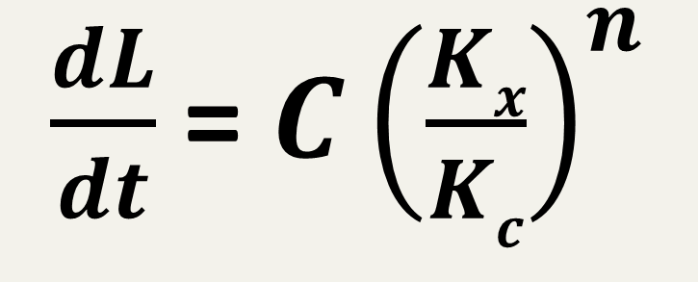
Modeling Subcritical Crack Growth
Classically by Paris’ Law (cyclic loads) and Charles’ Law (static loads)
$\frac{dL}{dt}$ = $C{\left(\frac{Kx}{Kc}\right)}^{n}$
Notes:
The proportion of the stress on the rock to the critical stress times a constant and then raised to this exponent n ‘subcritical crack growth index’. Just thinking of cracking in this way we can go to the literature and get some ideas about sediment size.
1st – n is rock-dependent; lower values results in faster cracking rates.

Slide 16

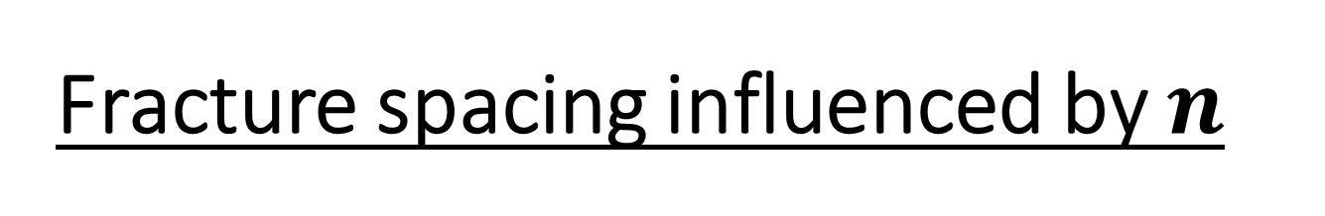


Fracture spacing influenced by $n$
$$n=5$$
$$n=20$$
$$n=80$$
10 cm
From: Olson, Jon E. "Predicting fracture swarms—The influence of subcritical crack growth and the crack-tip process zone on joint spacing in rock."
Geological Society, London, Special Publications 231.1 (2004): 73-88.

Slide 17
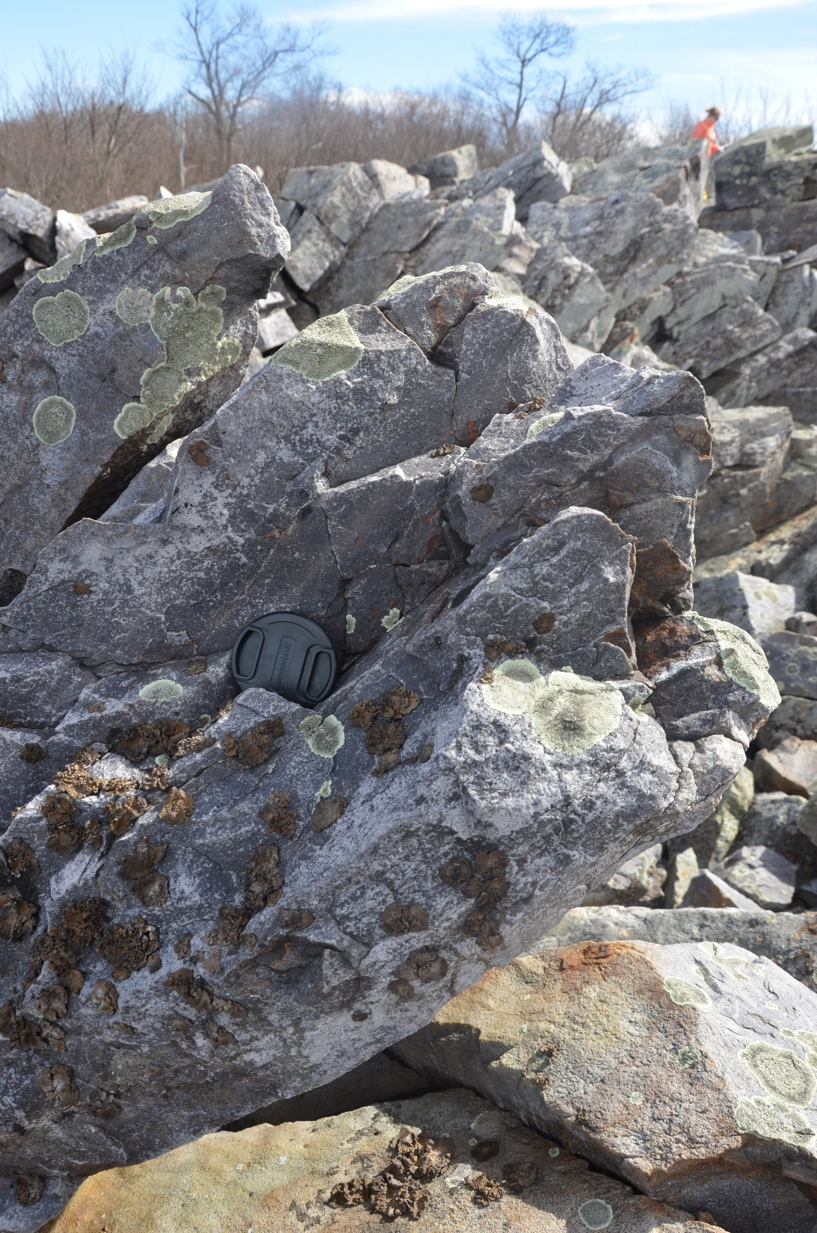
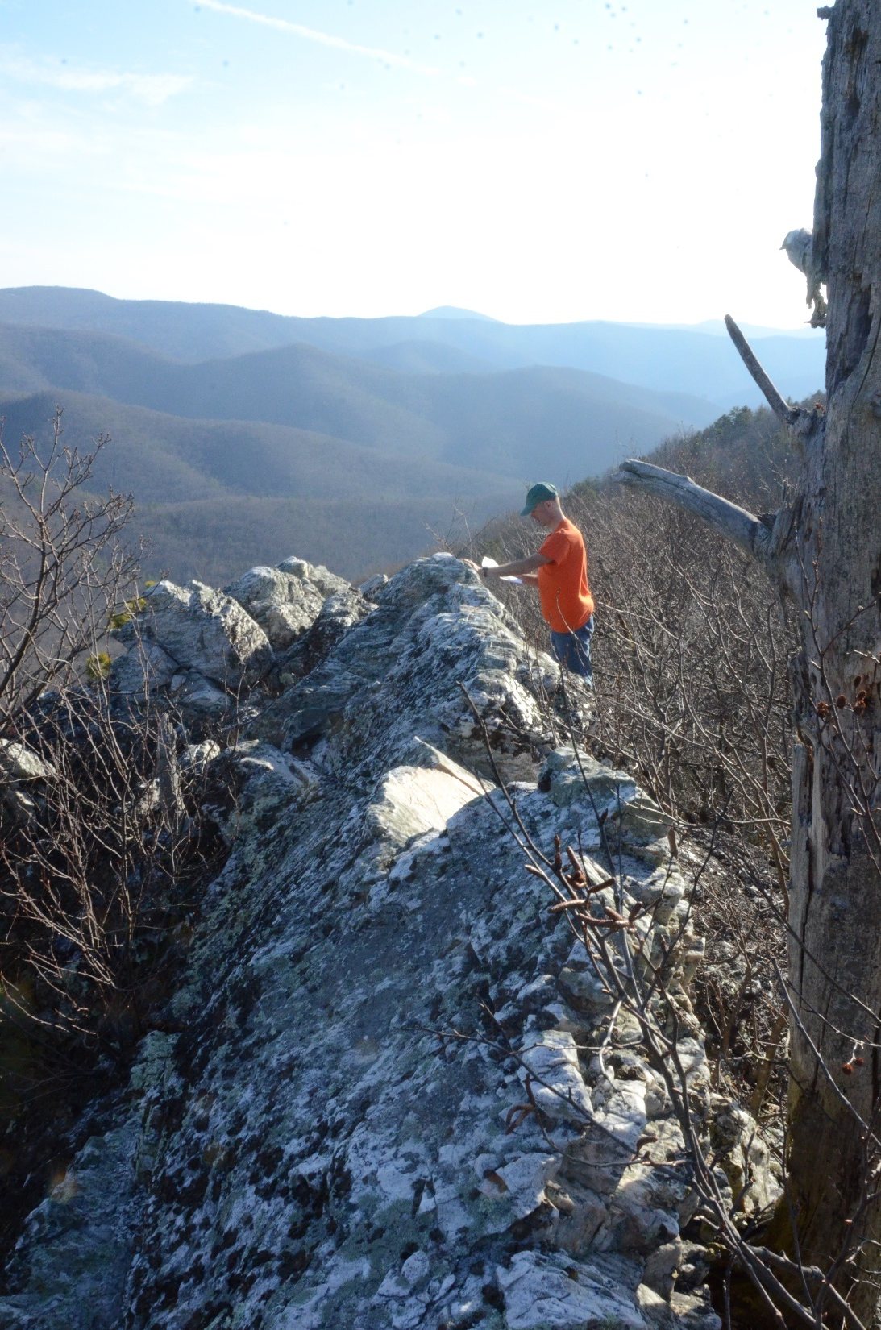
G.S. Hancock, in prep
What drives variance in n?

Slide 18
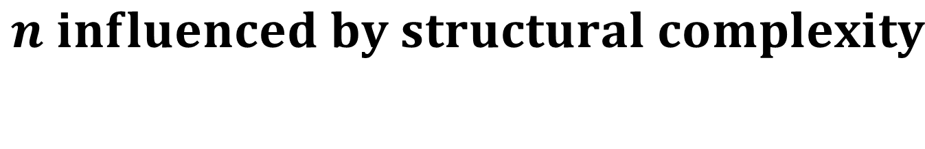
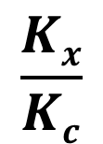
$$n influenced by structural complexity$$
n = 10
low n
Increasing complexity
high n
$$\frac{Kx}{Kc}$$
Swanson, 1984
JGR 89

Slide 19
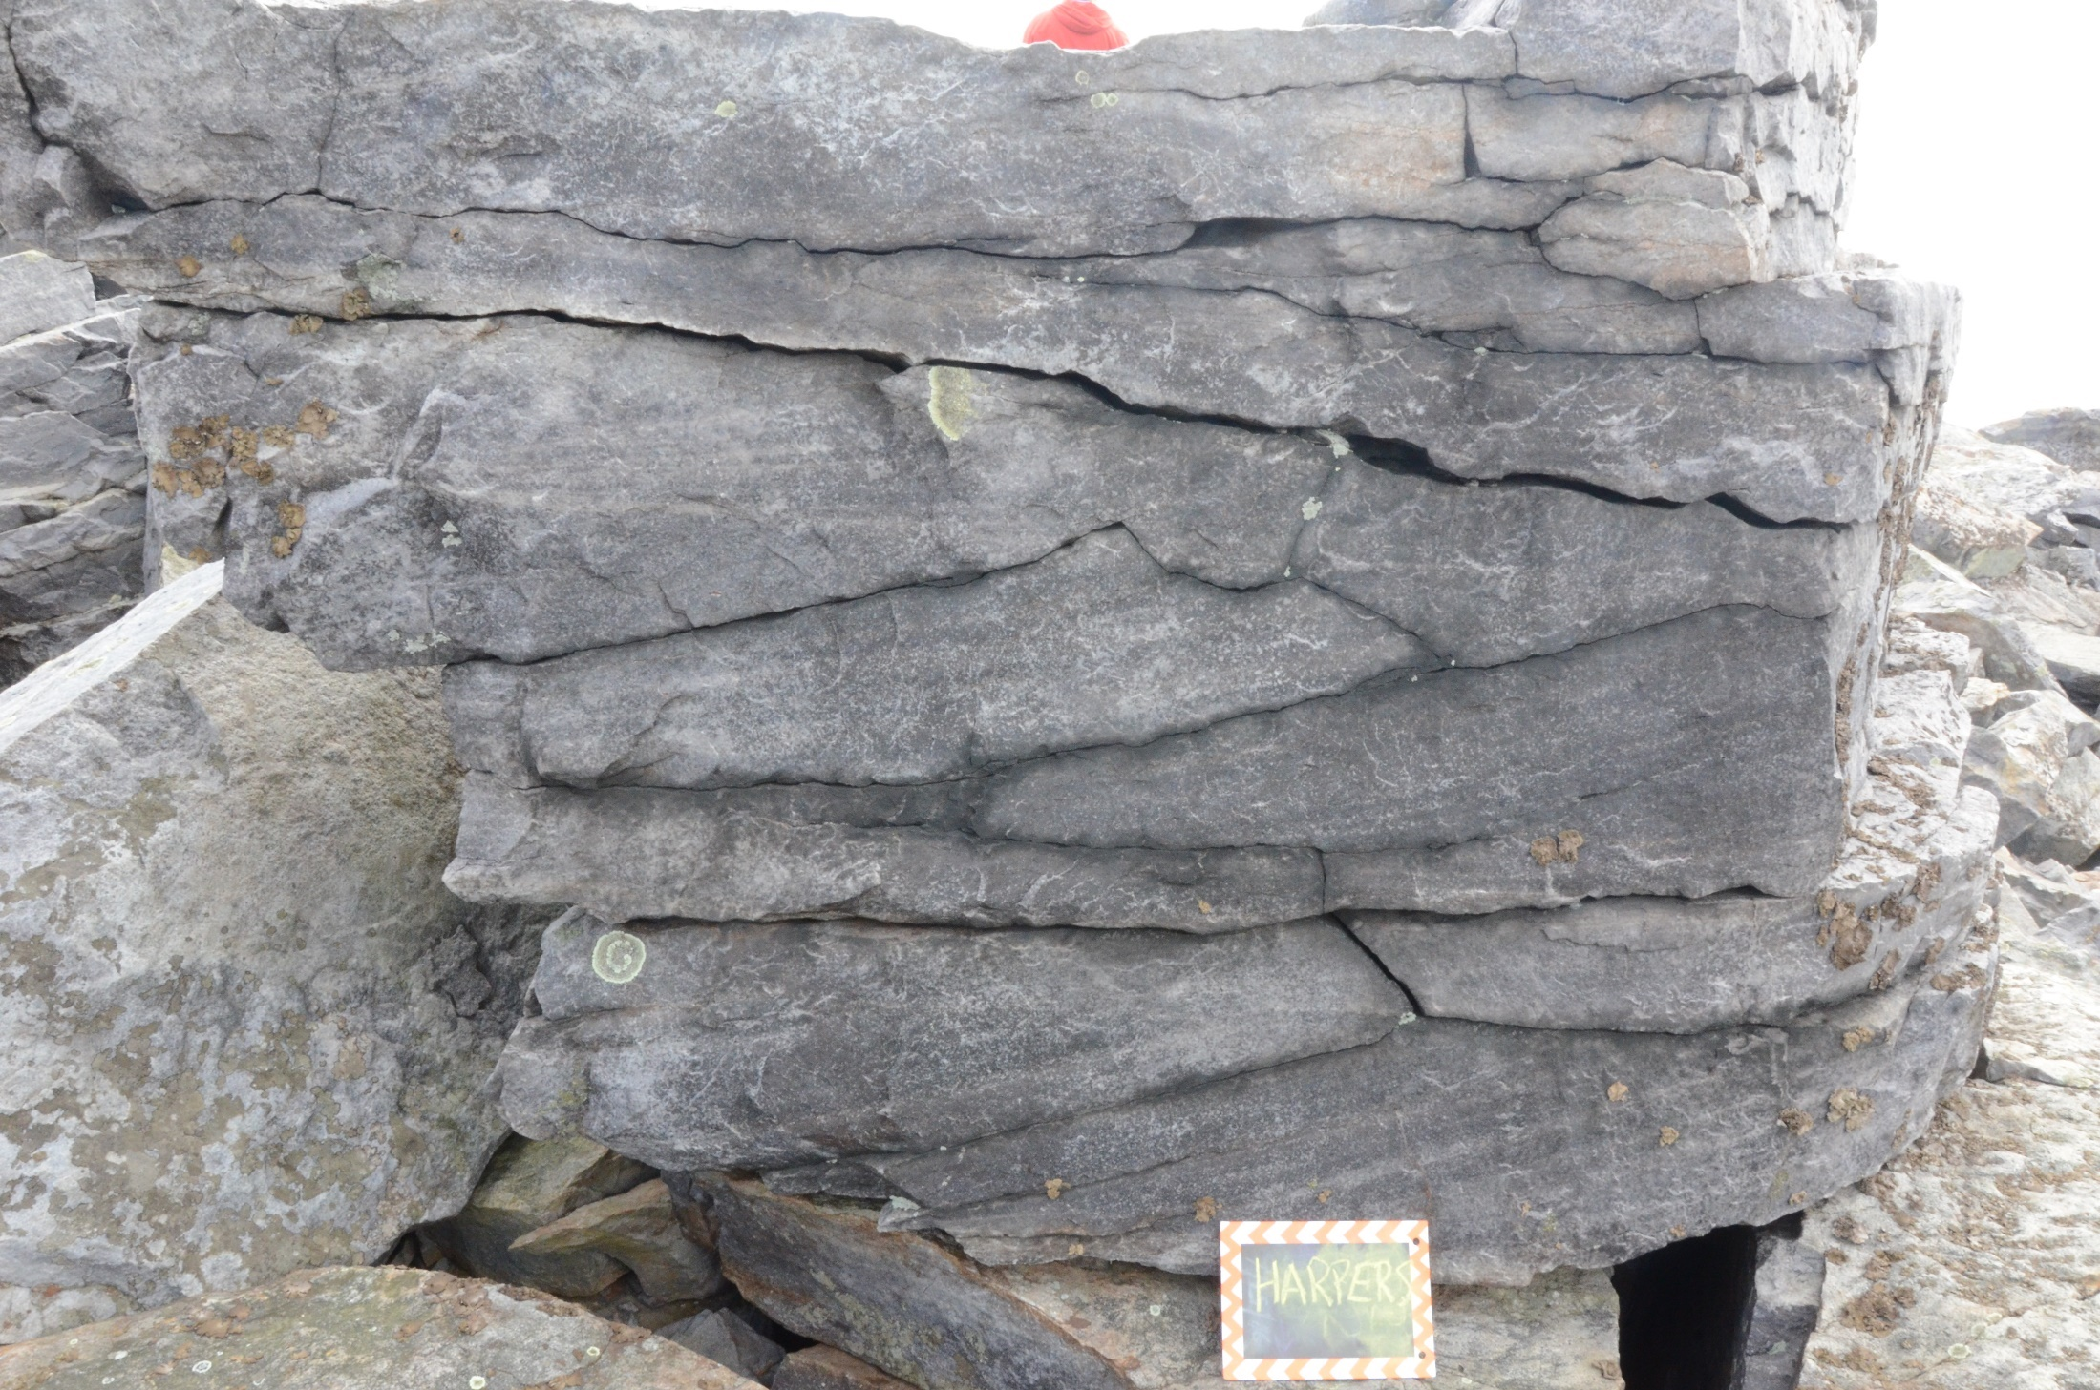

Slide 20
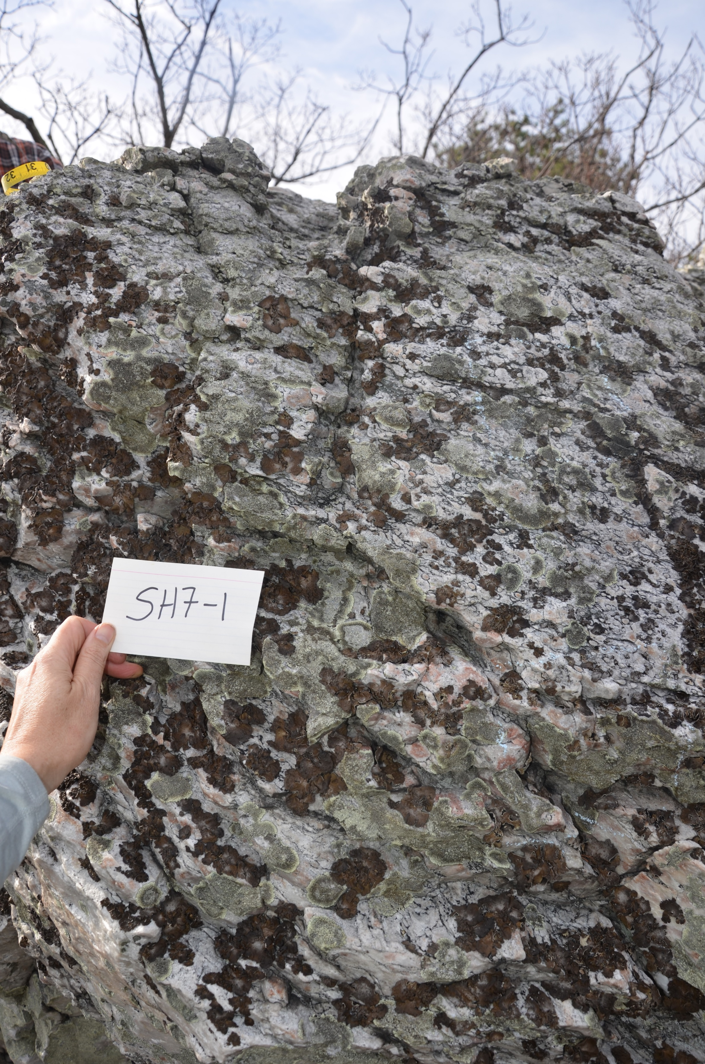
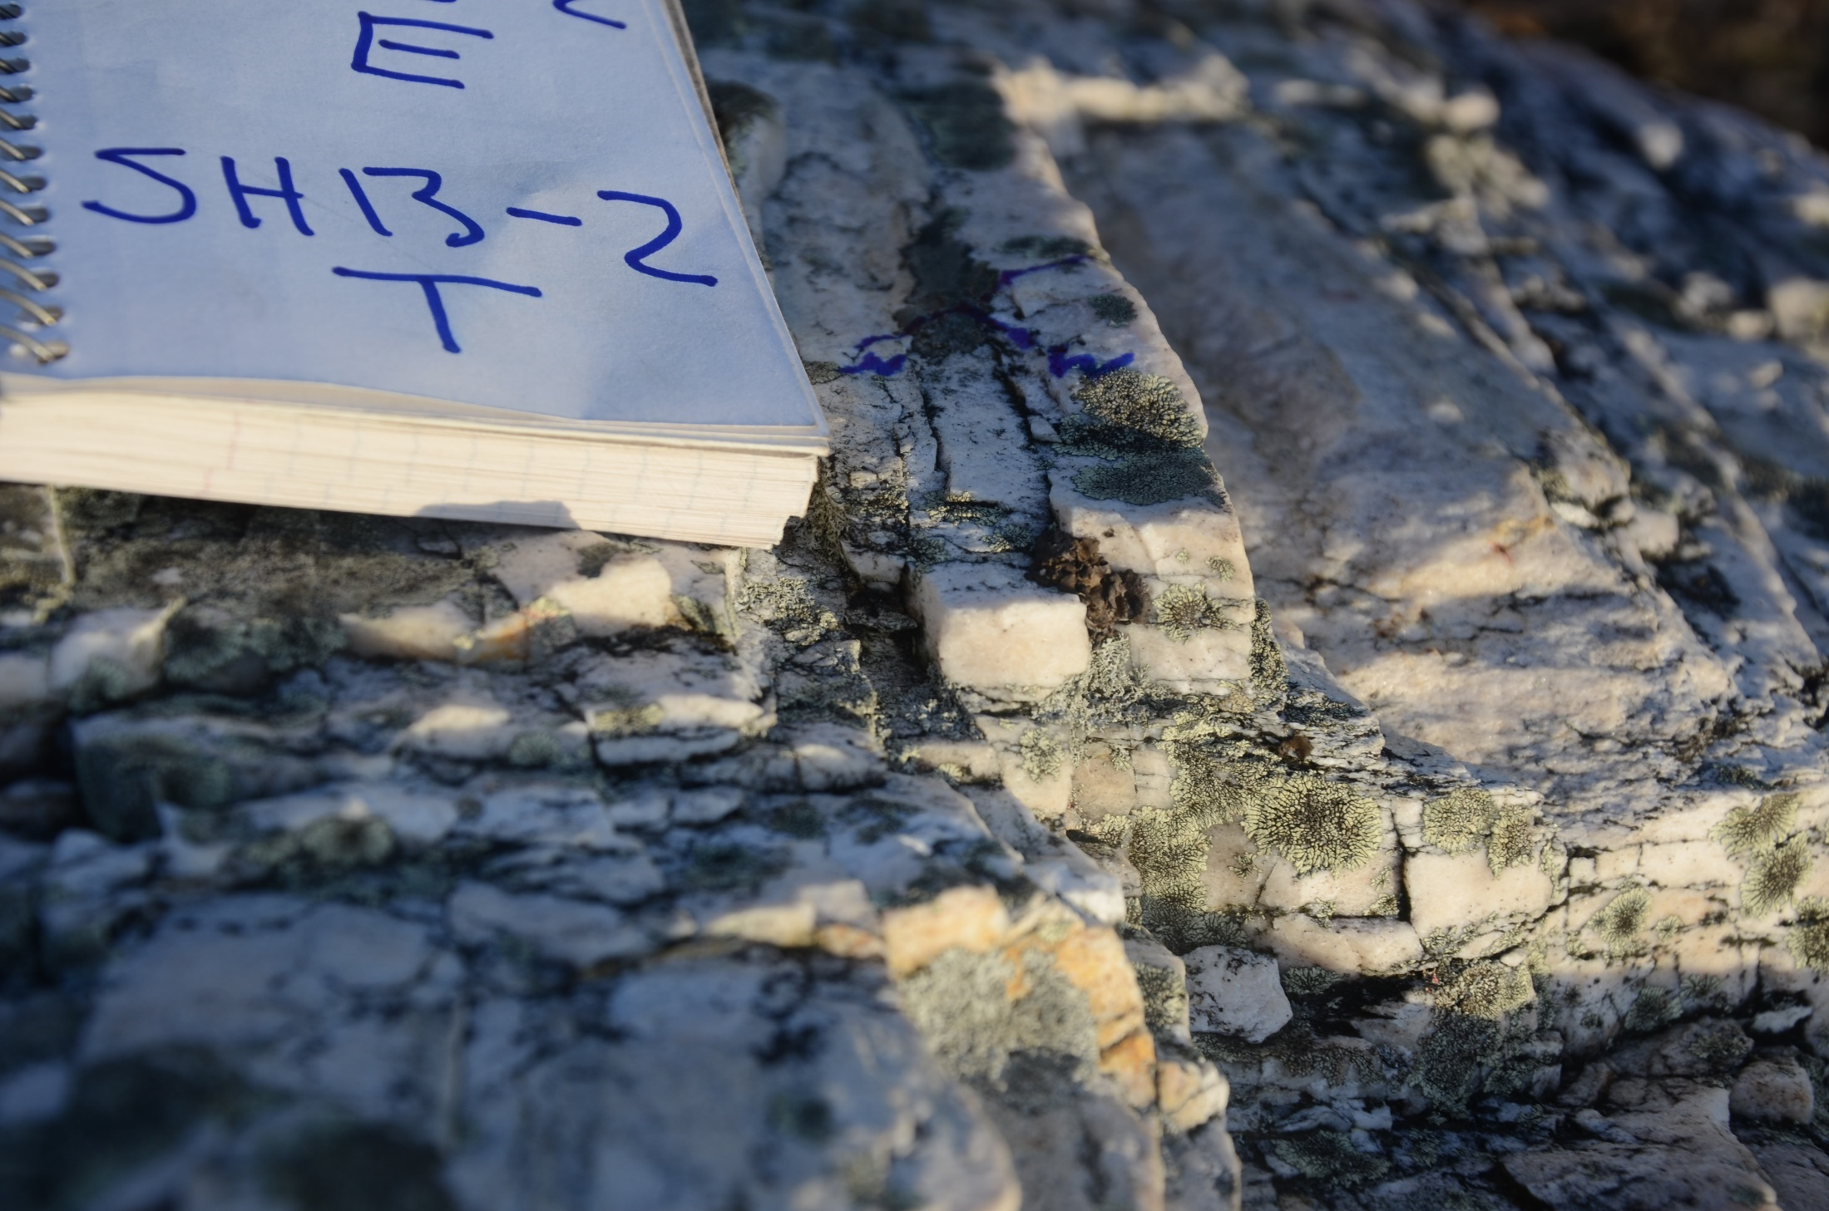

Slide 21
Meta‐Sandstone Outcrops
Average 10Be Erosion Rates
23.3 m/my
Antietam Quartzite Outcrops
Average 10Be Erosion Rates
4.7 m/my
G.S. Hancock, in prep
n influences erosion rates?
G.S. Hancock & Huettenmoser, this meeting

Slide 22
Modeling Subcritical Crack Growth under different environmental conditions
$\frac{dL}{dt}$ = $C{\left(\frac{Kx}{Kc}\right)}^{n}$
Notes:
If we know something about different stress loading causing different styles of fracturing, you can strat playing around with hrte enviaron condio under which that will happen.You can choose your pet stress – thermal and ask yourself under what conditions will it produce significant crack growth

Slide 23
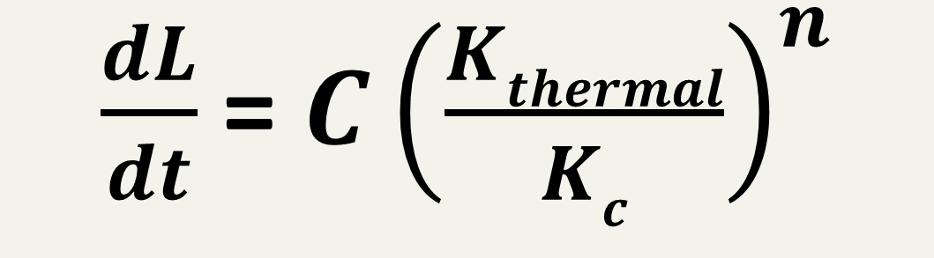
Case Study: Thermal Stresses in a Boulder
$\frac{dL}{dt}$ = $C{\left(\frac{Kthermal}{Kc}\right)}^{n}$

Slide 24
Macroscale Solar-Induced Thermal Stresses
σ_{macro}
σ _{macro}

Slide 25
Macroscale Solar-Induced Thermal Stresses
McFadden et al., 2005
Adelsberger and Smith, 2009
Eppes et al, 2010
D’arcy et al., 2014
Aldred et al., 2015
σ_{macro}
σ _{macro}

Slide 26
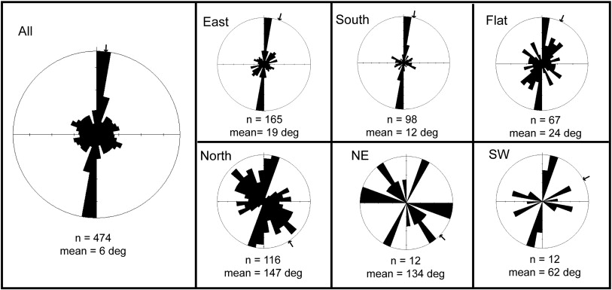
Slope Aspect control on the efficacy of
solar-induced through-going fracture
Adelsberger and Smith, 2009; Egypt

Slide 27
Macroscale Thermal Stress (1 day)
Numerical Modeling by Mackenzie-Helnwein & Hallet
in Eppes et al., 2016; GSA Bulletin

Slide 28
α₂
α₄
microscale solar-induced thermal stresses
α₁
α₃
α₂
α₄
α₁
α₂
σ_{micro}
Notes:
My colleague and I set out to model subcritical crack growth driven only by these stresses.

Slide 29
α₂
α₄
microscale solar-induced thermal stresses
α₁
α₃
α₂
α₄
α₁
α₂
σ_{micro}
Gomez-Heras, 2006
Eppes and Griffing, 2010
Notes:
My colleague and I set out to model subcritical crack growth driven only by these stresses. How to determine when you are going to get which of them??What insight can looking tat this through sccg give us. First, the environmental conditions under which you might get any of them.

Slide 30
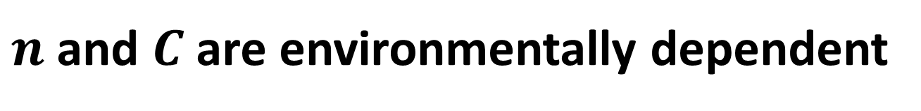
Modeling Subcritical Crack Growth under different environmental conditions
$\frac{dL}{dt}$ = $C{\left(\frac{Kx}{Kc}\right)}^{n}$
$n$ and $C$ are environmentally dependent

Slide 31
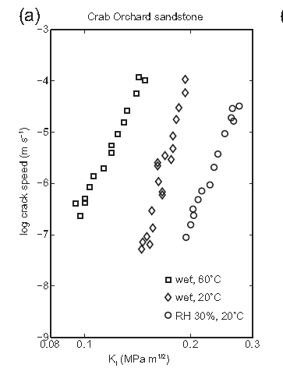
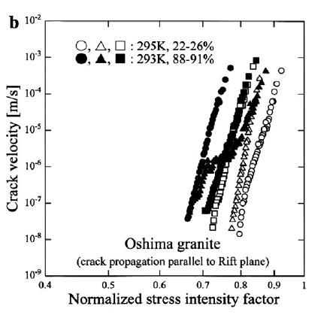
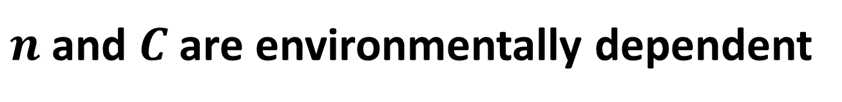
$n$ and $C$ are environmentally dependent
Wet Dry
humid Dry
Nara et al., 2012
Atkinson 1987
Notes:
We know from fracture mefchnancis experriments in rock that dry cracks propagate more slowly than wet crack.
Textbook
Importantly,
In all the experiments dry cracks propagate more slowly than wet cracks and the reason is that the primary process thought to drive subcritical crack grwoth in rocks is something called stress corrosion.

Slide 32
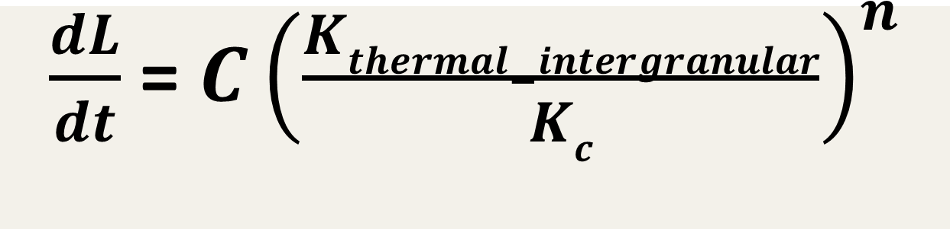
Modeling Subcritical Crack Growth due to intergranular thermal stresses
(Eppes & Keanini, in preparation)
            Model Parameters
Crack growth – intergranular thermal stresses only
$\frac{dL}{dt}$ = $C{\left(\frac{Kthermal−intergranular}{Kc}\right)}^{n}$

Slide 33
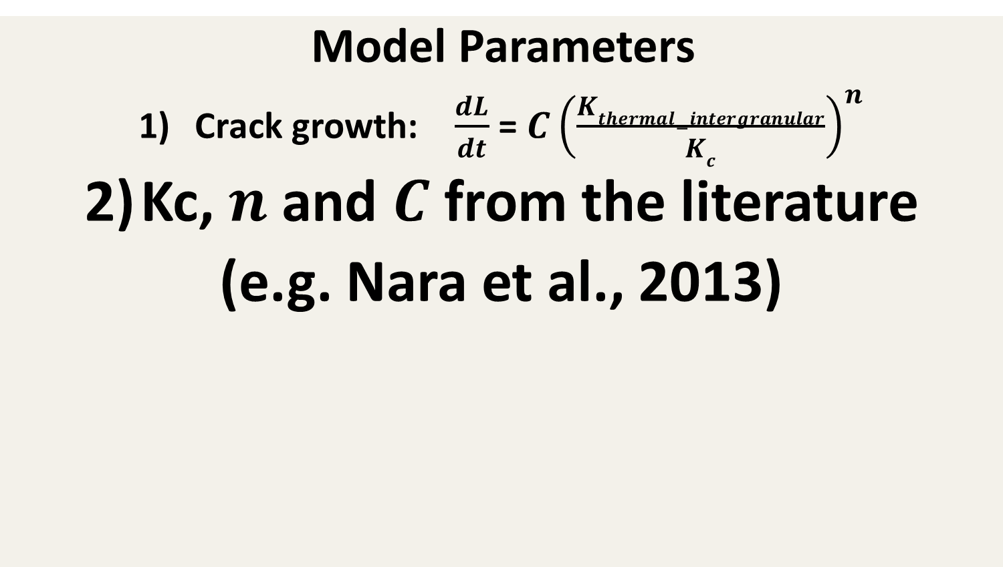
Modeling Crack Growth in Granite due to intergranular thermal stresses
(Eppes & Keanini, in preparation)
            Model Parameters
Crack growth: $\frac{dL}{dt}$ = $C{\left(\frac{Kthermal−intergranular}{Kc}\right)}^{n}$
Kc, $n$ and $C$ from the literature
(e.g. Nara et al., 2013)

Slide 34
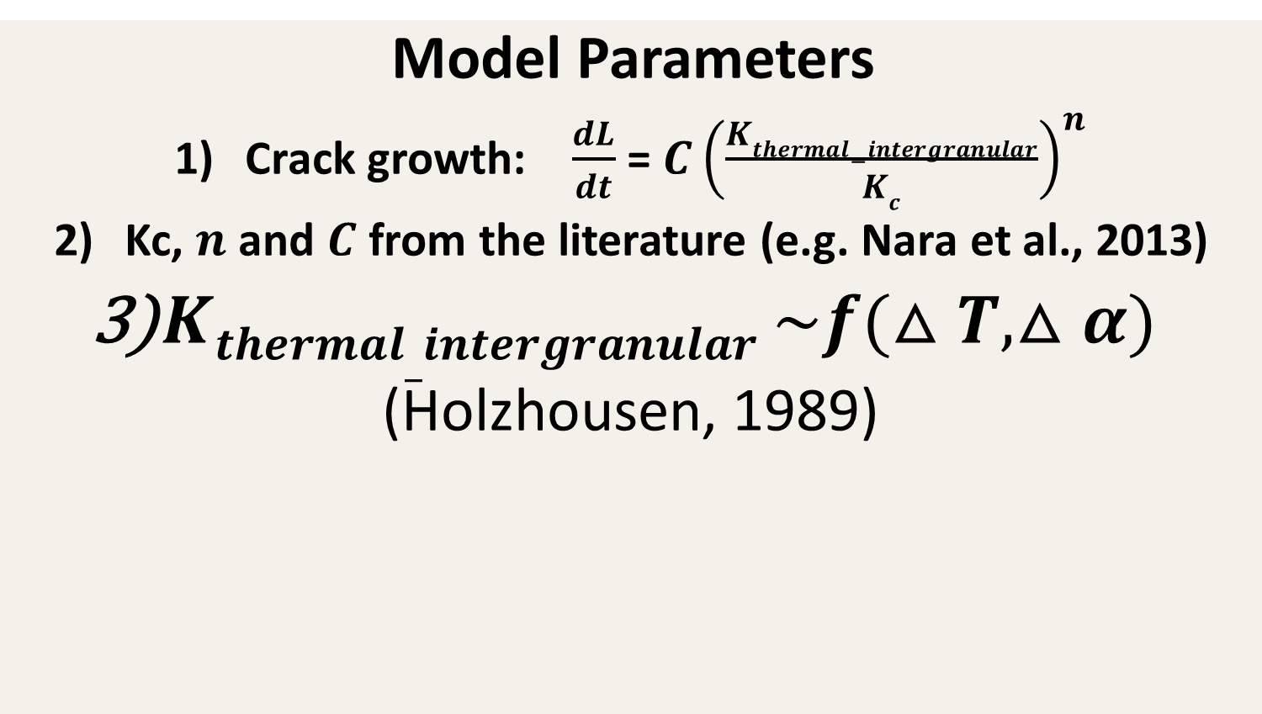
Modeling Crack Growth in Granite due to intergranular thermal stresses
(Eppes & Keanini, in preparation)
            Model Parameters
Crack growth: $\frac{dL}{dt}$ = $C{\left(\frac{Kthermal−intergranular}{Kc}\right)}^{n}$
Kc, $n$ and $C$ from the literature (e.g. Nara et al., 2013)
$Kthermal_intergranular \sim f(△T,△α)$
(Holzhousen, 1989)

Slide 35
Modeling Rock Erosion via
Intergranular Thermal Stress Driven
subcritical Crack Growth in Granite
(Eppes & Keanini, in preparation)

Slide 36
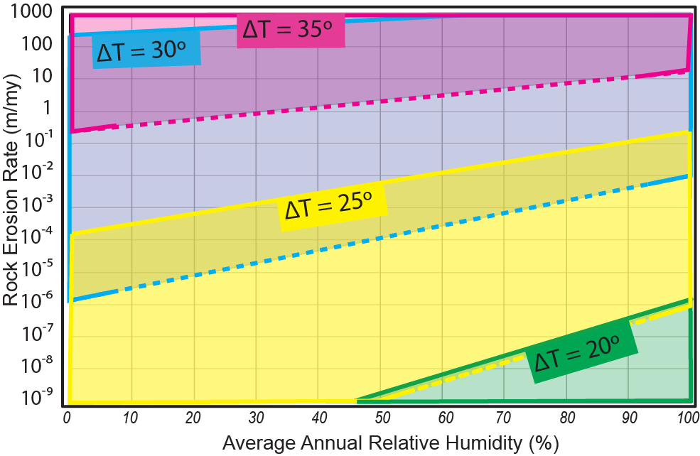
Range of Rock and Environment Conditions to foster
Significant granular disintegration
(Using average Kc & high (solid) & low (dashed)
Coef. Of Thermal Expansion from available literature)

Slide 37
Range of Rock and Environment Conditions to Foster
Significant Granular Disintegration
(Using average Kc from Available Literature)
Namibia & New Mexico Boulders
(Sumner et al., 2004; Eppes, unpublished)
NC Boulder (Eppes et al., 2016)

Slide 38
Conclusions
Rocks on slopes break down through subcritical crack growth.

Slide 39
Conclusions
Rocks on slopes break down through subcritical crack growth.
Subcritical crack growth parameters thus influence the style of breakdown
and likely the size of sediment being produced

Slide 40
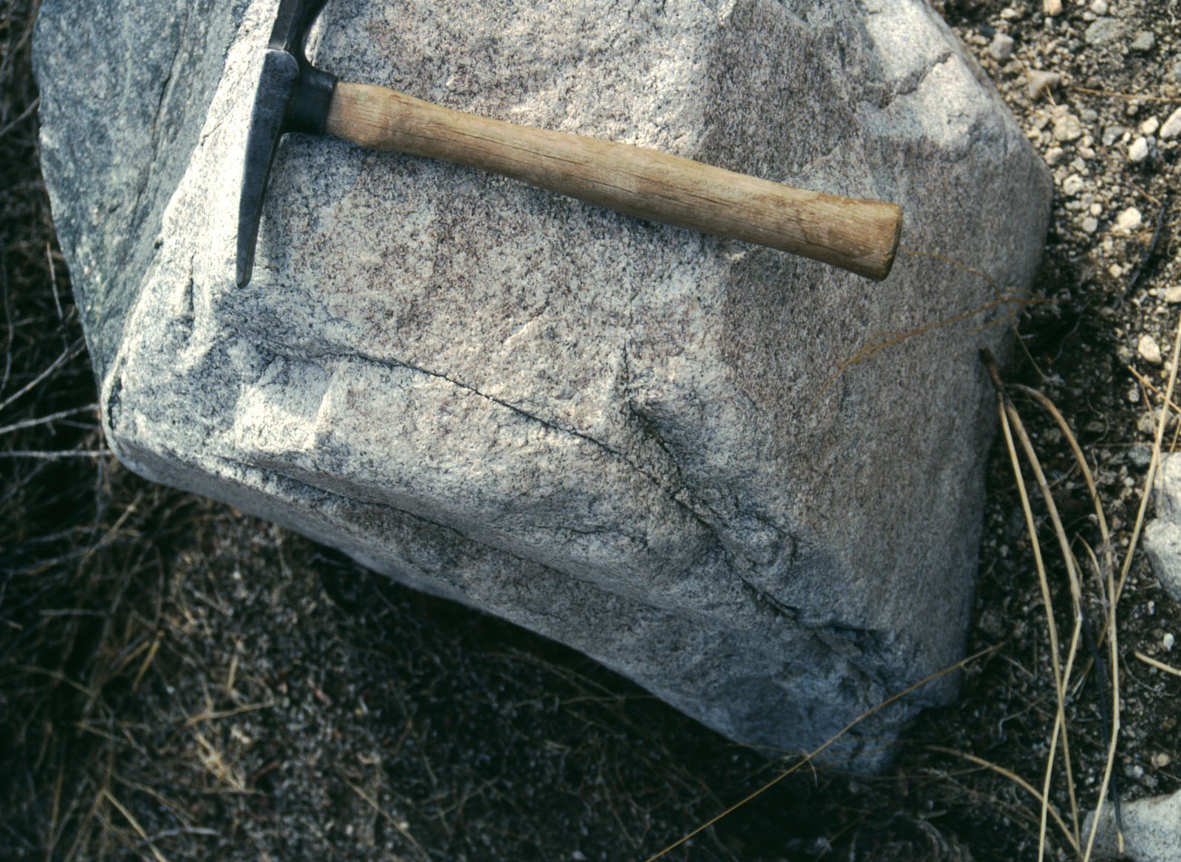

Slide 41
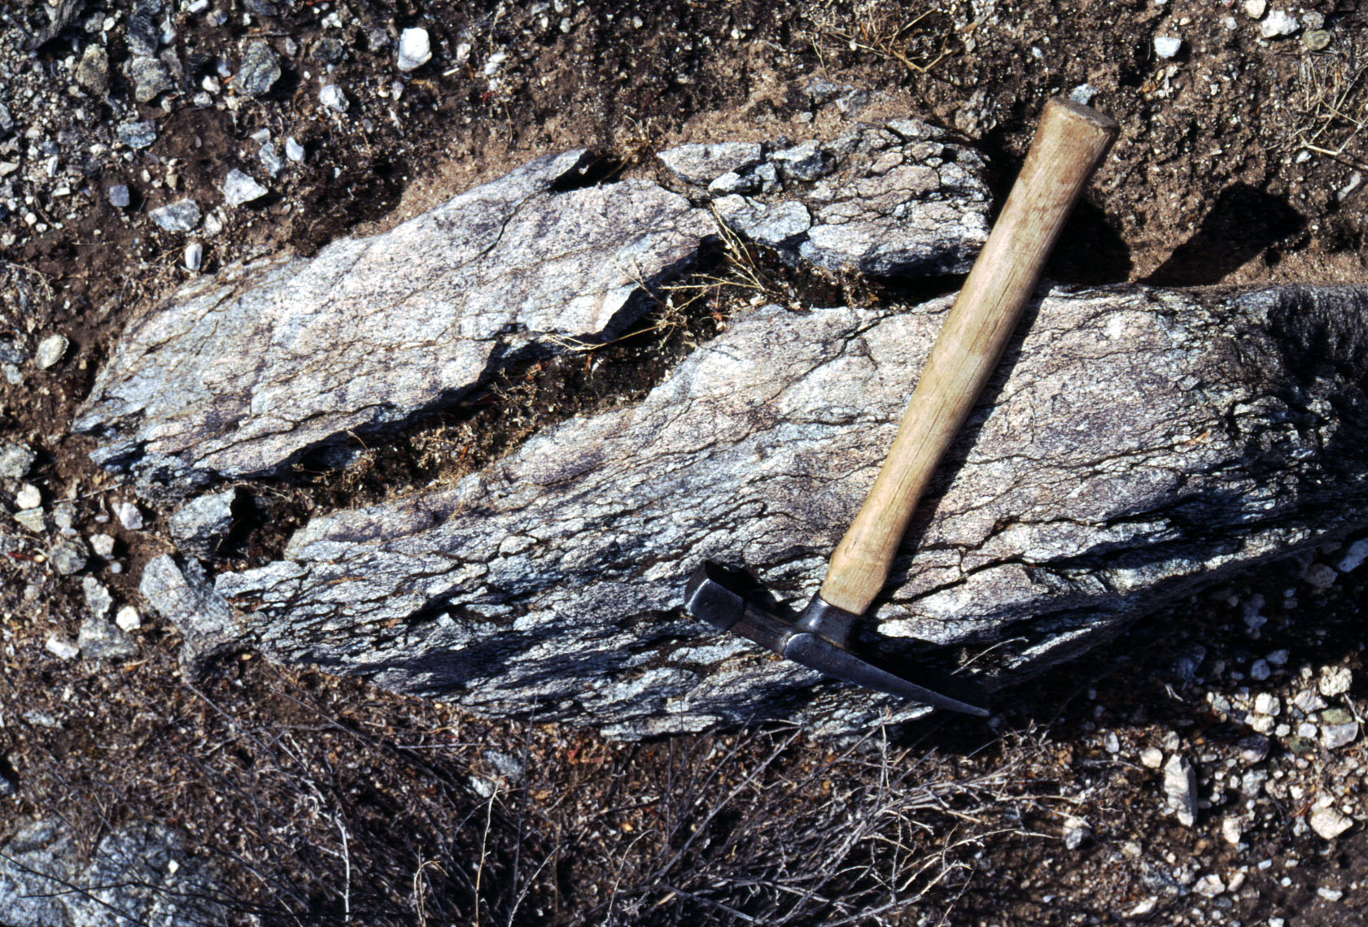

Slide 42
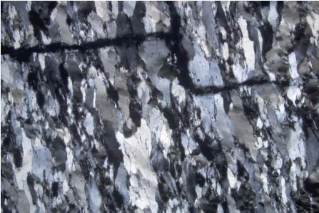

Slide 43
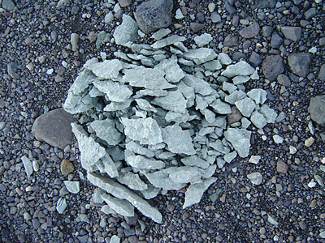

Slide 44
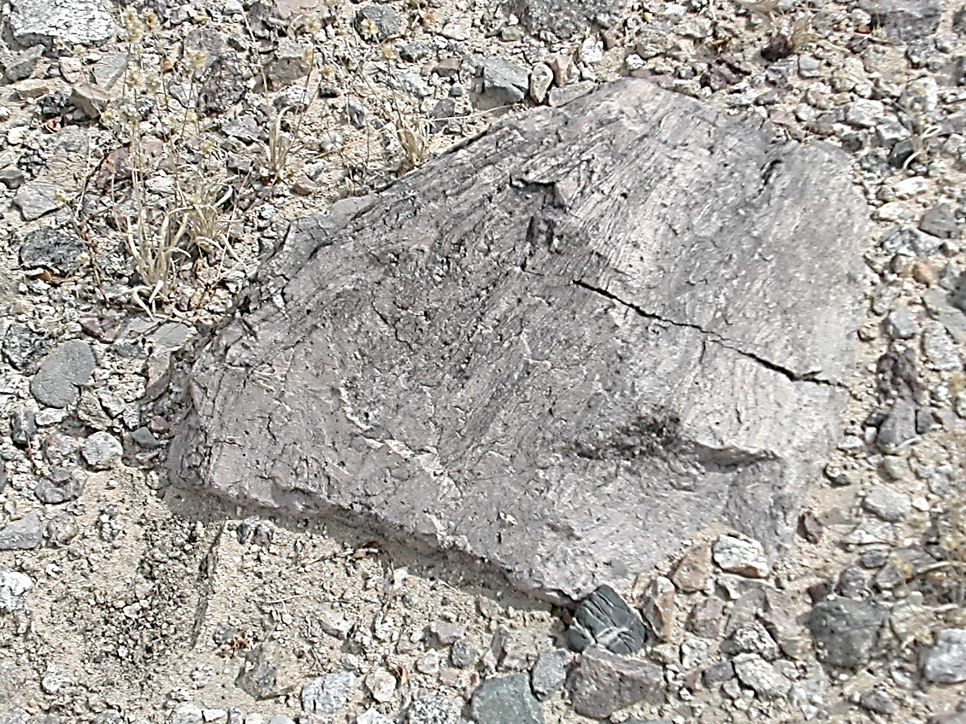

Slide 45
Processes of Subcritical Crack Growth
Fatigue
Ion
Dissolution
Stress Corrosion
Notes:
SCCG occurs due tto the fac that stresses are amplified at the crack tip.

Slide 46
Processes of Subcritical Crack Growth
Fatigue
Ion
Dissolution
Stress Corrosion
Notes:
SCCG occurs due tto the fac that stresses are amplified at the crack tip.

Slide 48
All stresses acting on a crack are additive
K_{nth}
K_{c}
Crack
growth
rate
ΔL/T
Weathering Stresses
K ((MPa₁ + MPa₂ + Mpa_{i}) m^{1/2} )
Notes:
So if that is the case, then what do we need to know about sc crack growth?
Most weathering stresses likely fall in this stress range, so that means that cracks are going very slowly, over very long time scales.
Futhermore, there are many processes that constitute sccg

Slide 50
Macroscale Solar-Induced Thermal Stresses
σ_{macro}
σ _{macro}

Slide 51
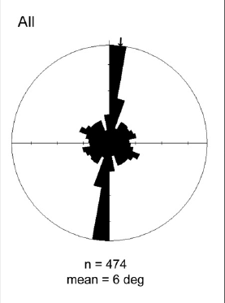
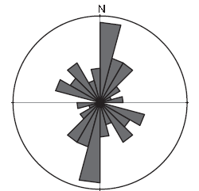
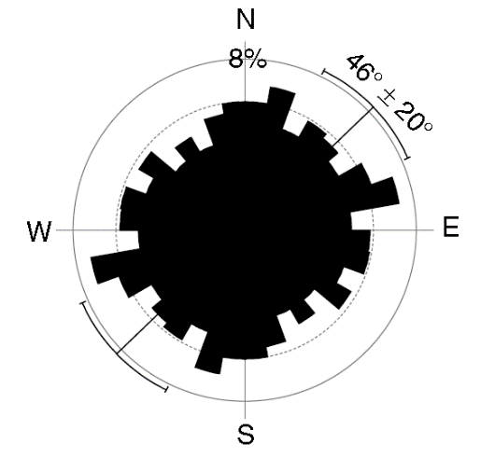
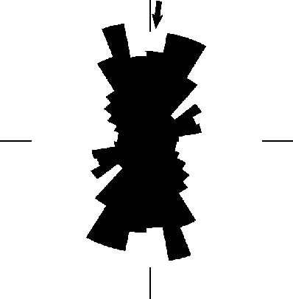
Cracks in desert boulders exhibit preferred orientations
Southwestern US
McFadden et al., 2005
Gobi Desert
Eppes et al., 2010
Central Egypt
Adelsberger et al., 2009
Owens Valley, CA
D’Arcy et al., 2014
Mars
Eppes et al., 2015
Notes:
It was concluded that these oriernatations are bdue to the repeated geometries of stresses that arise daily in rocks due to the repeated pattern of heating induced on thetm by th esun.
Time and again these cracks exhibit preferred NE orientatinos that we feel strongly links their origins back to the sun.
So when I moved to NC I was naturally very curios if I would find similar results for the Eastern united states

Slide 52
Notes:
So all we need is a little stress and some humidity in the crack. Ok, now let’s start to think about what insight we ight gain from thinking of weathering in this way. First we need a stress.

Slide 53
Macroscale Solar-Induced Thermal Stresses
σ_{macro}
σ _{macro}

